Slide 1

CiakTime
Human Computer Interaction Course Prof.ssa Catarci Prof.ssa Mirabella A.A. 2020/2021
Mauro Ficorella – 1941639 Martina Turbessi – 1944497 Valentina Sisti - 1952657

Slide 2
Idea
We are presenting CiakTime, an app designed for cinema lovers.
This app offers the following functionalities:
Search for movies or persons
Read information about plot, cast, year of release, duration, genre, movie director and streaming platform on which the movie is available
Read biography and see filmography of a person
Look for popular and upcoming movies
Keep track of already watched movies, movies to watch and favourite movies
Review and rate movies
Comment and like reviews made by other users

Slide 3




Competitors analysis
IMDb
+500k downloads
Strengths:
Huge fanbase
Reference app regarding cinema and movies
Limitless cinema database
Offers information about showtimes and theatres
Suggests movies based on users’ watchlists
Weaknesses:
No exchange of opinions between users
No possibility to keep track of already watched movies
No possibility to save favourite movies in a list
It’s not very intuitive retrieve movies specific information due to the high number of functionality offered by the application

Slide 4


Competitors analysis
Cinemaniac
+500k downloads
Strengths:
Keep track of watched movies
Possibility to save favourite movies in a list
Statistics about user watch history and preferences
Weaknesses:
Interface not so user friendly
No user interaction
No information about streaming platform
Search about movies not intuitive
In-app purchases to remove advertisements and unlock some functionalities

Slide 5


Competitors analysis
 | CiakTime | IMDb | Cinemaniac
User profile
Search
Movie info
Streaming platform
Upcoming movies
Watch history
Watch list
Favourite movies
Review movies
Rate movies
Comment other reviews
Like other reviews
No ads

Slide 6



User profile
Age | 18-50 years
Gender
Profession | Any
Education | Any
Location | Any
Technology | Basic smartphone experience
Passions | Cinema, movies

Slide 7

Persona
Vittoria is 25 years-old and comes from Rome. She is a university student and in the free time her main hobby is watching movies and tv-series on her favourite streaming platforms.
During her study breaks she likes to keep in touch with her friends on various social apps.
Scenario
Vittoria has just terminated an intense study session and now she only wants to relax watching a movie. She decides to call her best friend to spend the evening together. Once she arrives, in order to choose which movie to watch, they both open the app to compare their watchlists. After a while they realize that they both have “La La Land“ in their watchlists and so they decide to watch it together.
At the end of the evening, they both check it as “watched“ in their app.

Slide 8
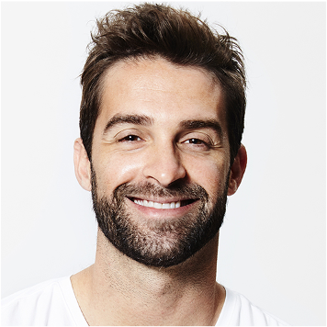
Persona
Emanuele is 33 years-old and comes from Torino. He is a programmer and he likes very much going to the cinema with his girlfriend.
As a programmer, he is addicted of technology in general, and more specifically of mobile devices; moreover, he is a very organized guy, and so he likes to keep under control everything he does in his life using mobile apps.
Scenario
It is an afternoon autumn day. Emanuele and his girlfriend would have liked to go out for a walk, but since it’s raining, they don’t know what to do. So, Emanuele opens the app in search of a popular movie. In this list he founds that is just available in the cinemas a new action movie with his favourite actor Vin Diesel; since also his girlfriend likes action movies, they decide to go to the cinema to watch it and spend a good afternoon together.

Slide 9
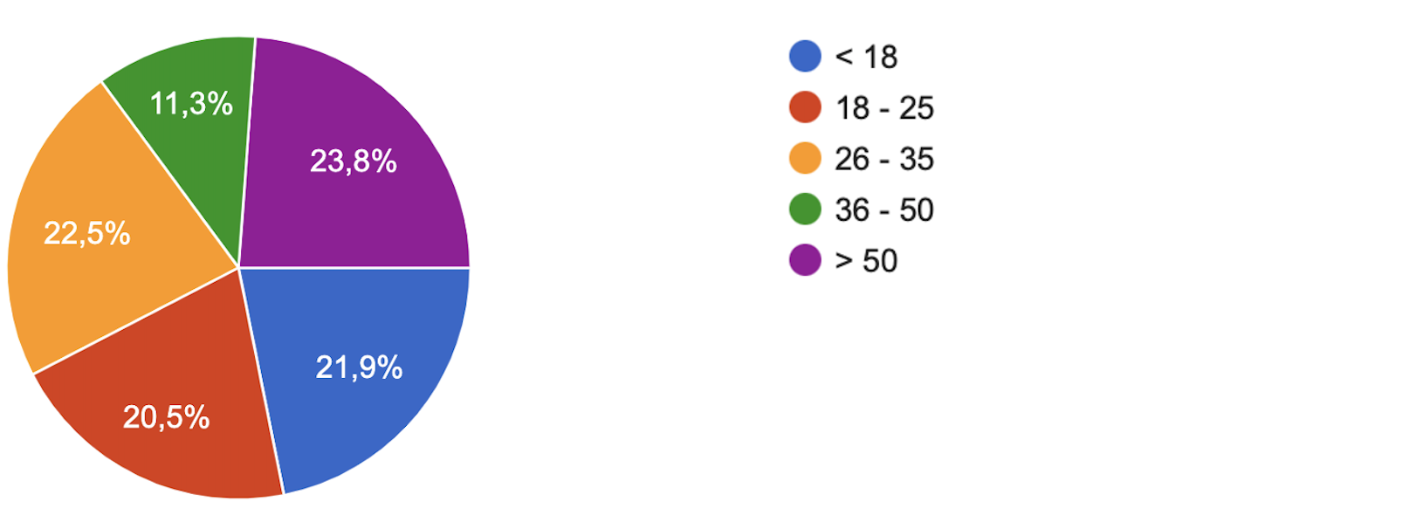
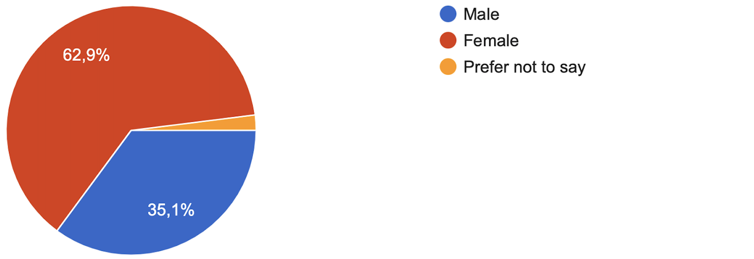
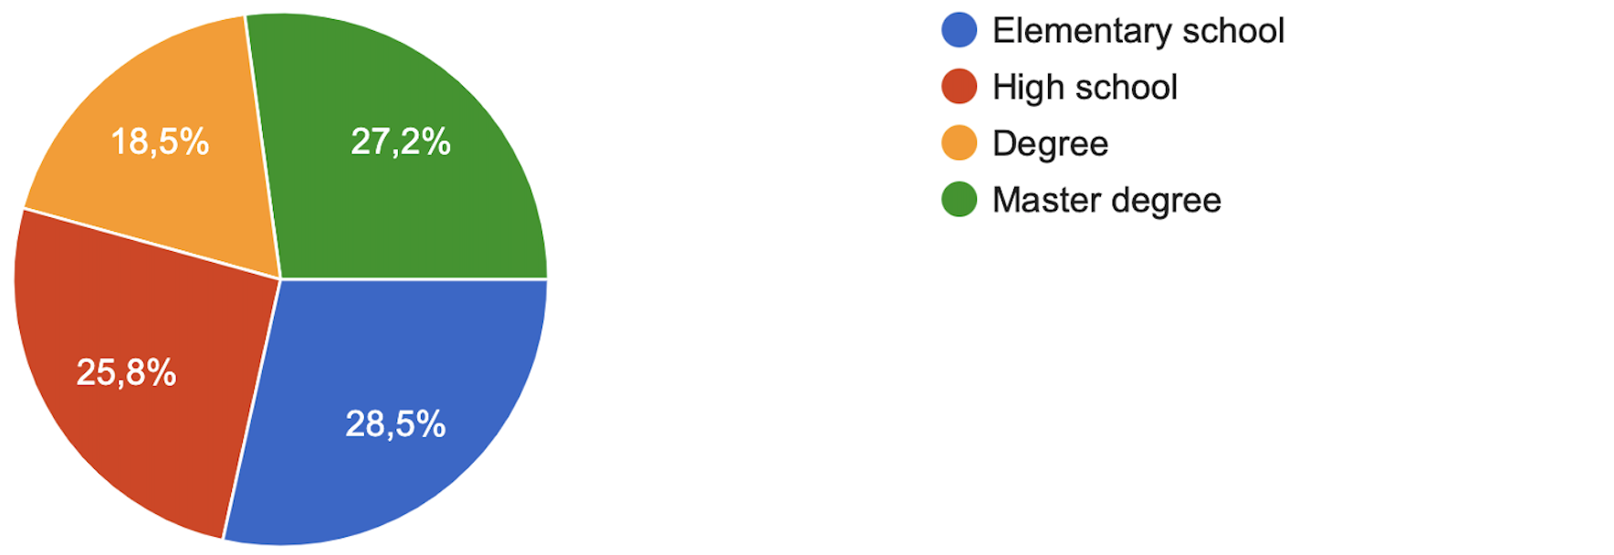
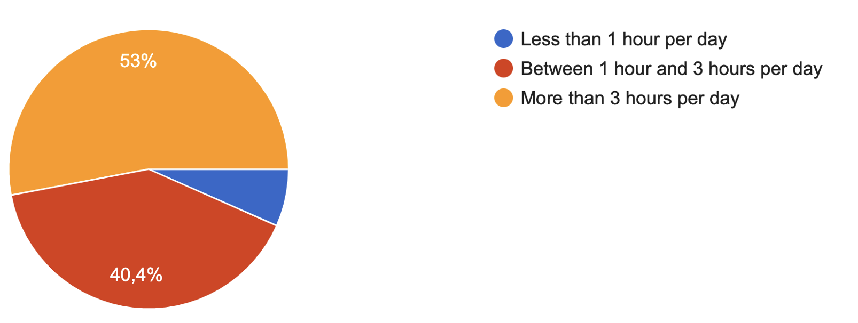
Questionnaire – Part 1
What's your age?
What's your gender?
What's your educational level?
How frequently do you use your smartphone on average?

Slide 10
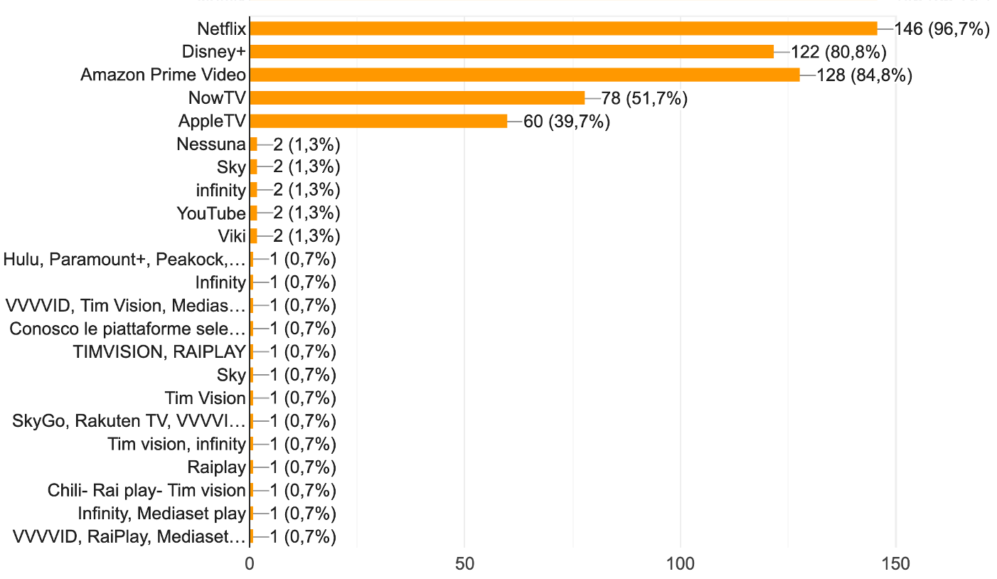
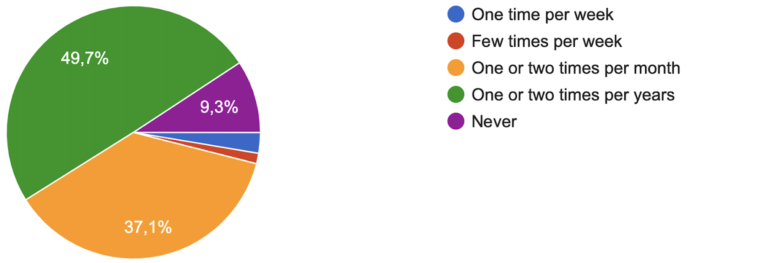
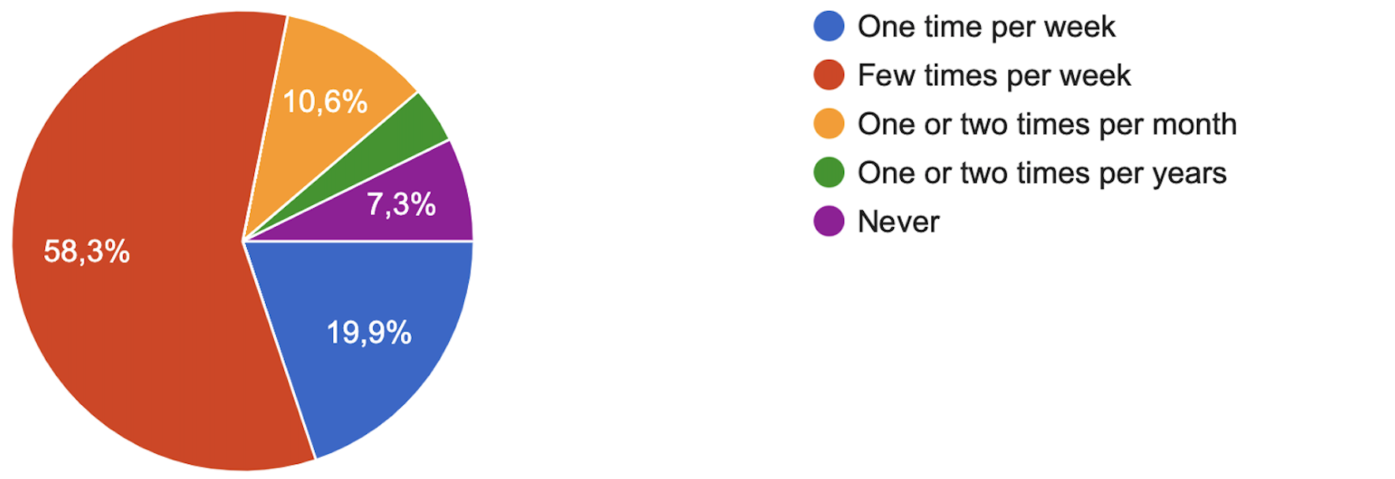
Questionnaire – Part 2
How many times do you go to the cinema on average? (Before pandemic)
Which streaming platforms do you know?
How many times do you watch movies on
streaming platforms/tv on average?

Slide 11
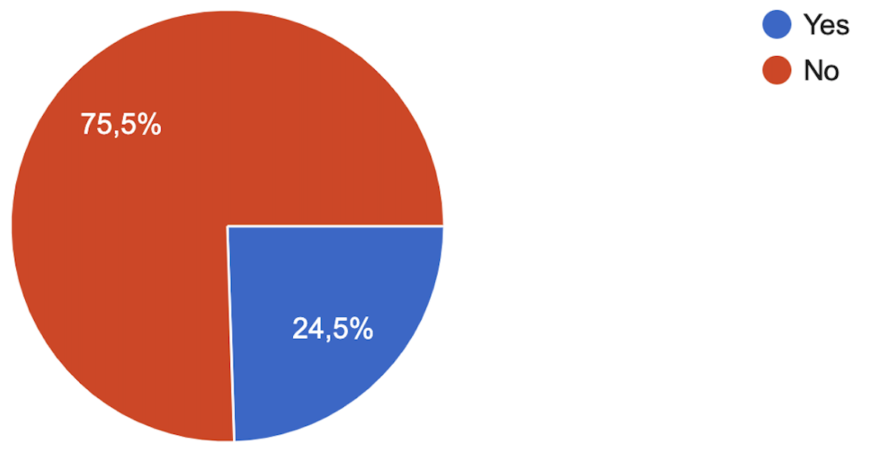
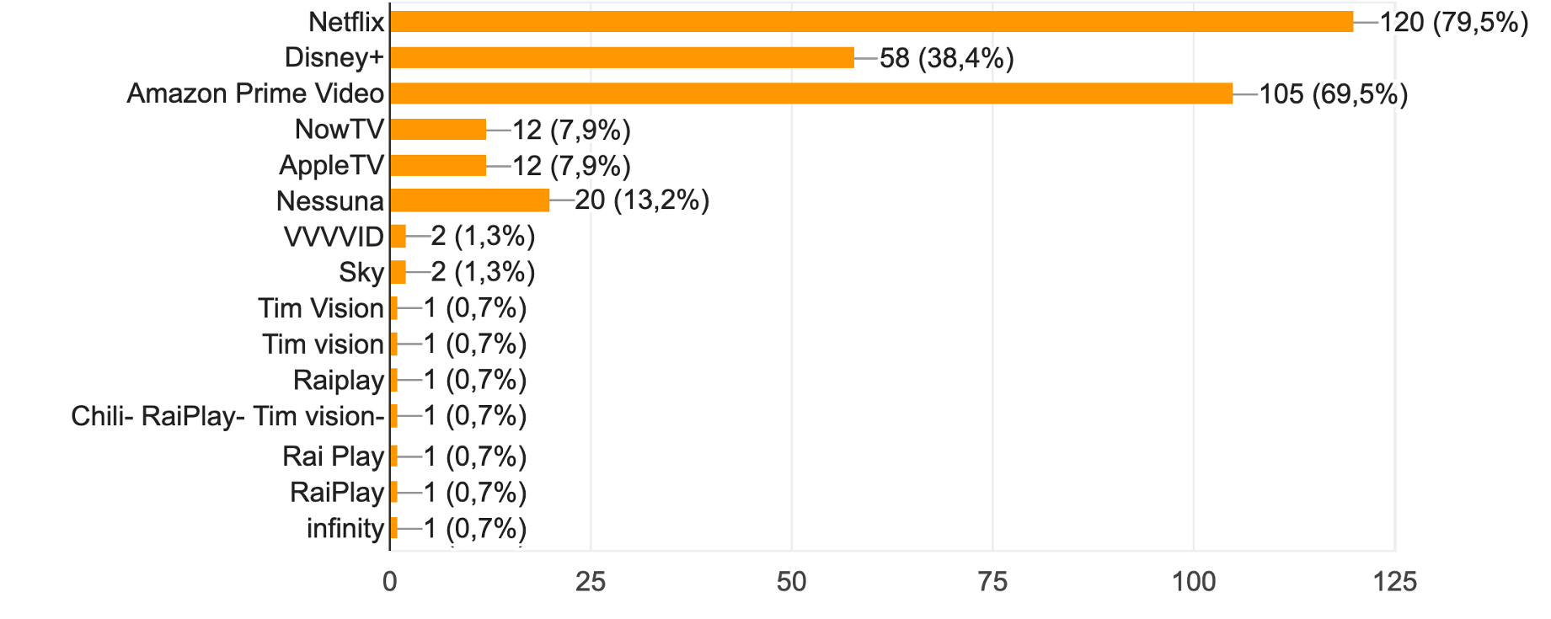
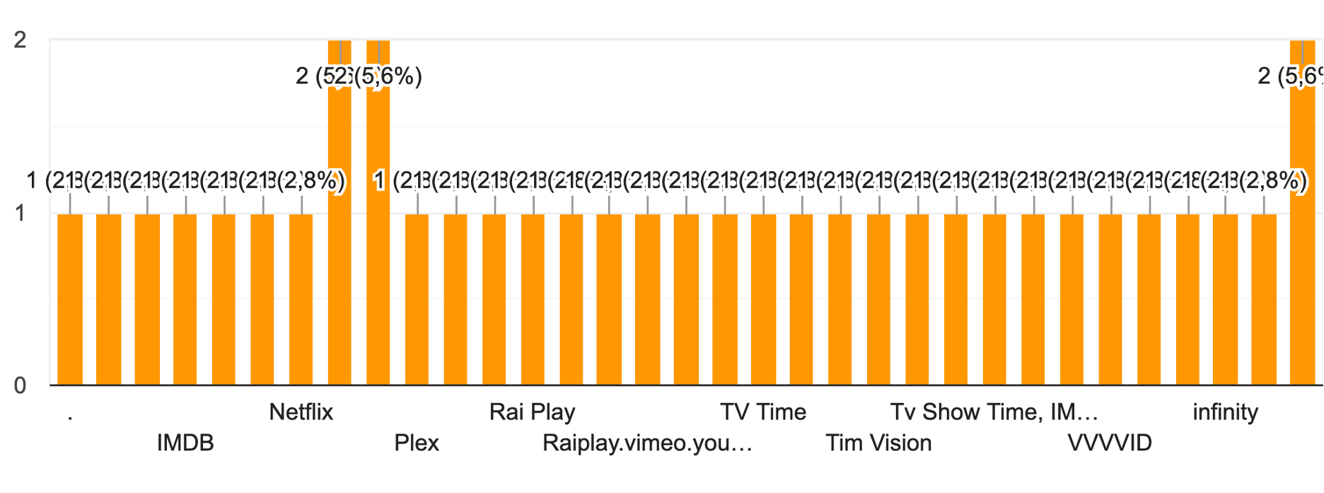
Questionnaire – Part 3
Do you use any movies related app?
Which streaming platforms do you use?
If you use any movies related app, which one?

Slide 12
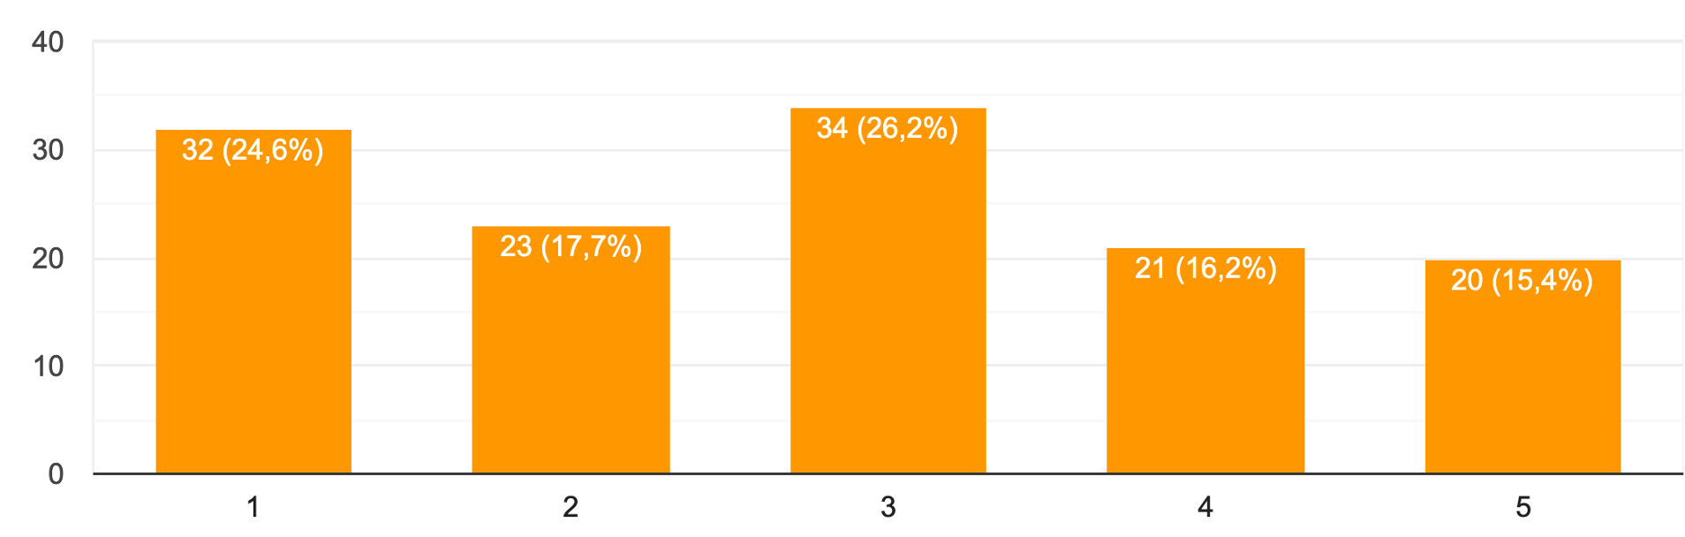
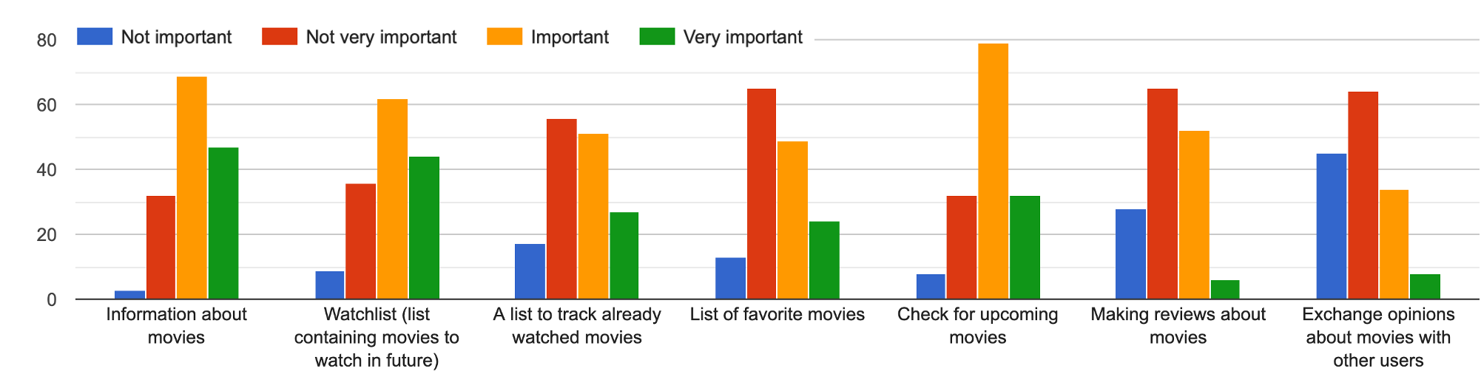
Questionnaire – Part 4
If you don't use any movies related app, how much would you be interest in using one?
How much do you think the following features are important in such an app?

Slide 13
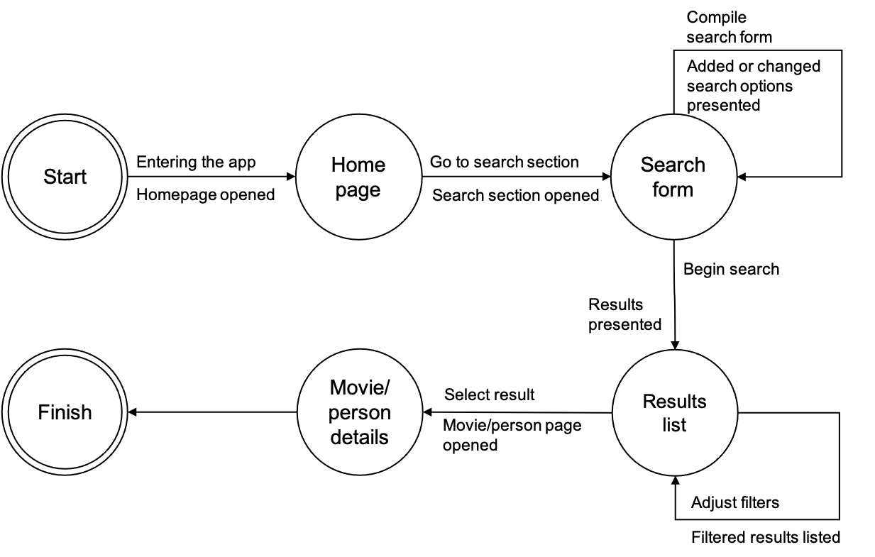
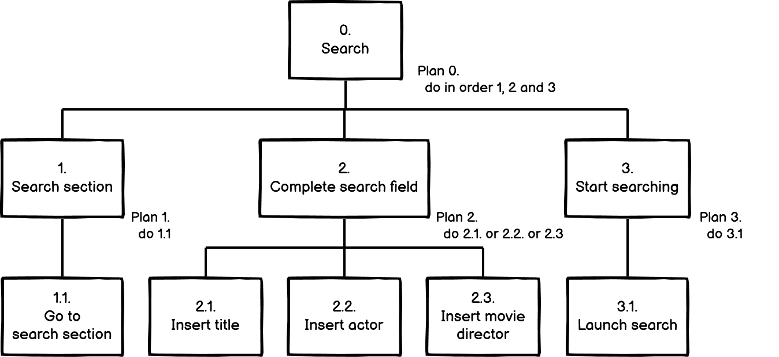
Search for a movie or a person
The user searches for the movie or the person he wants to know information about. He can do search by title, actor or movie director and, when the results are shown, he selects the result he is interested in.
HTA
STN

Slide 14
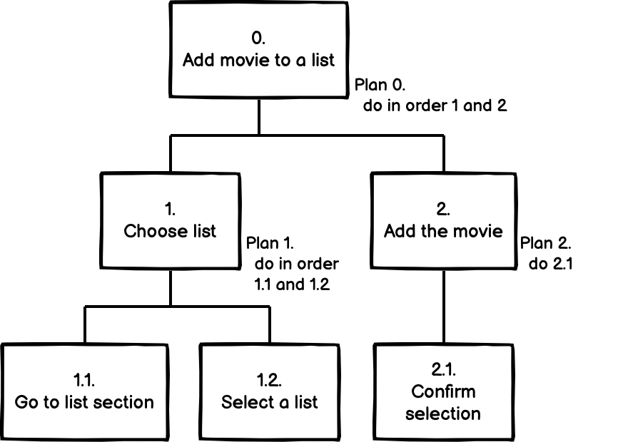
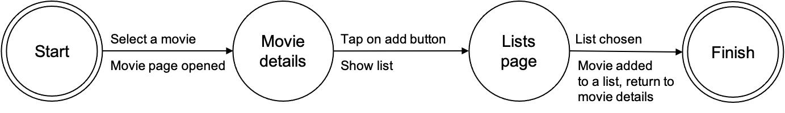
Add movie to a list
The user can add a movie into a list: he can choose between a watchlist that contains movies to watch in the future, a list containing movies already watched and a list containing favourite movies. We are assuming that the user has already selected a movie.
HTA
STN

Slide 15
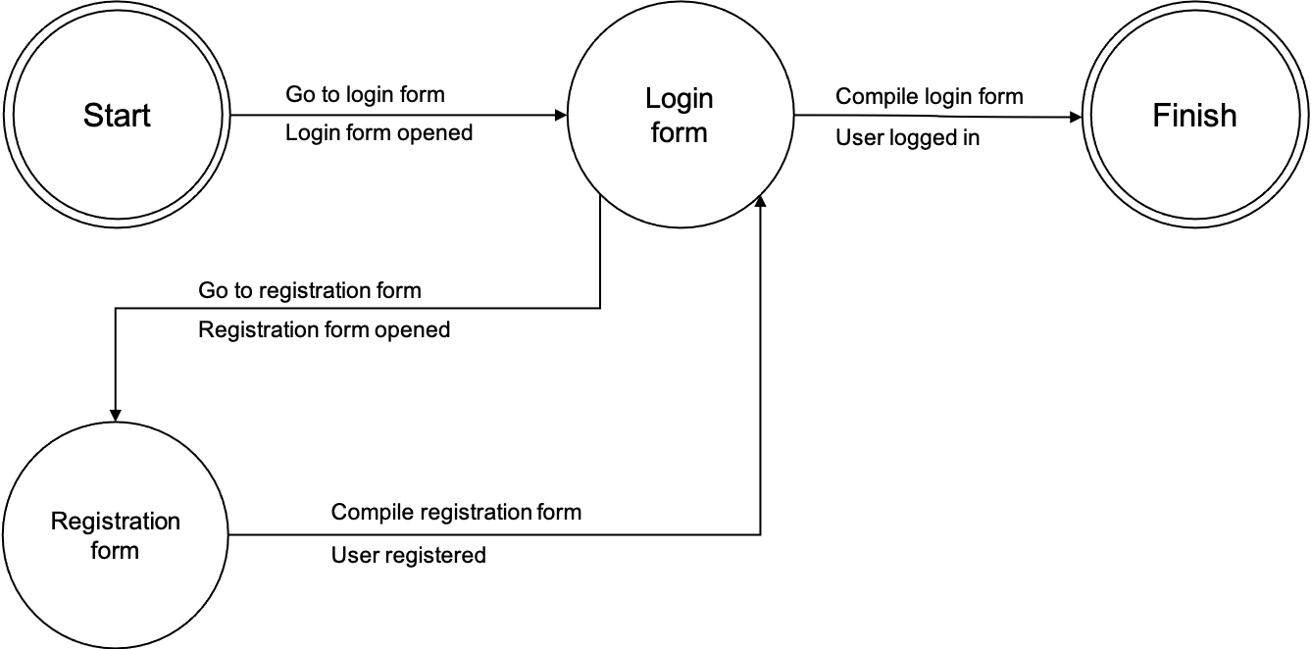
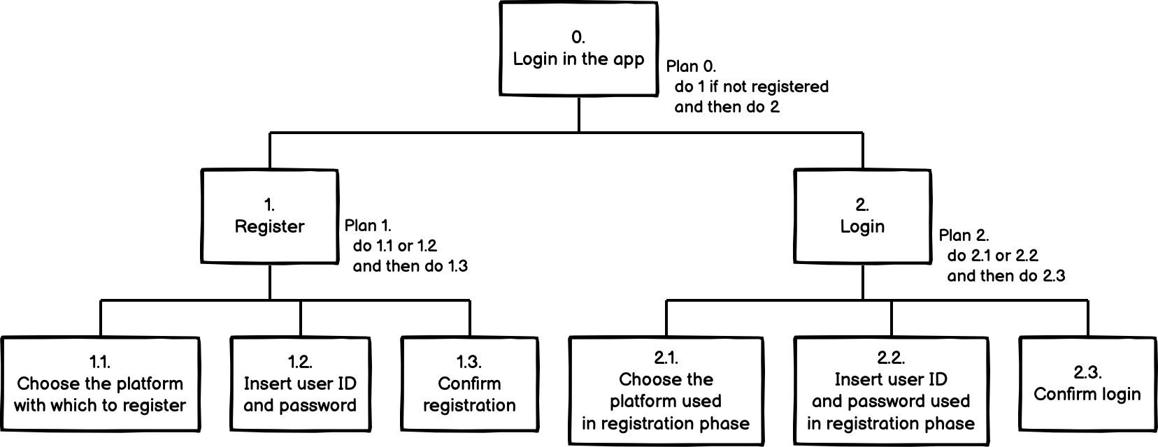
Login
The user can login into the app if registered, either through online platforms (Google, Facebook) or using his personal email and password, in order to save in the cloud all his data regarding the app.
From now on, in the following HTAs, we assume that the user is logged in.
HTA
STN

Slide 16
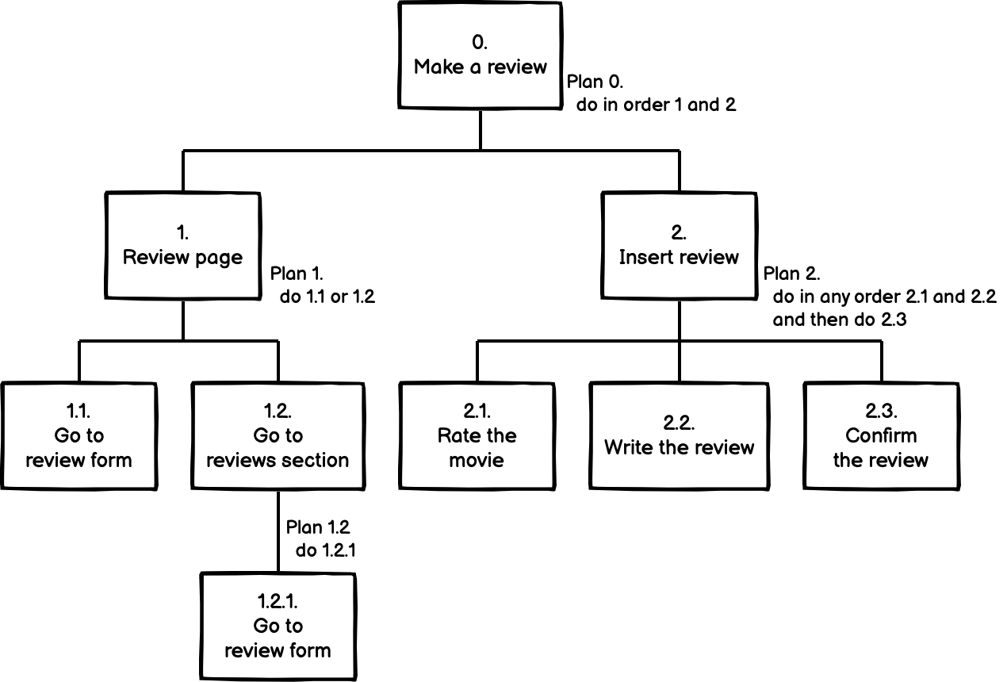
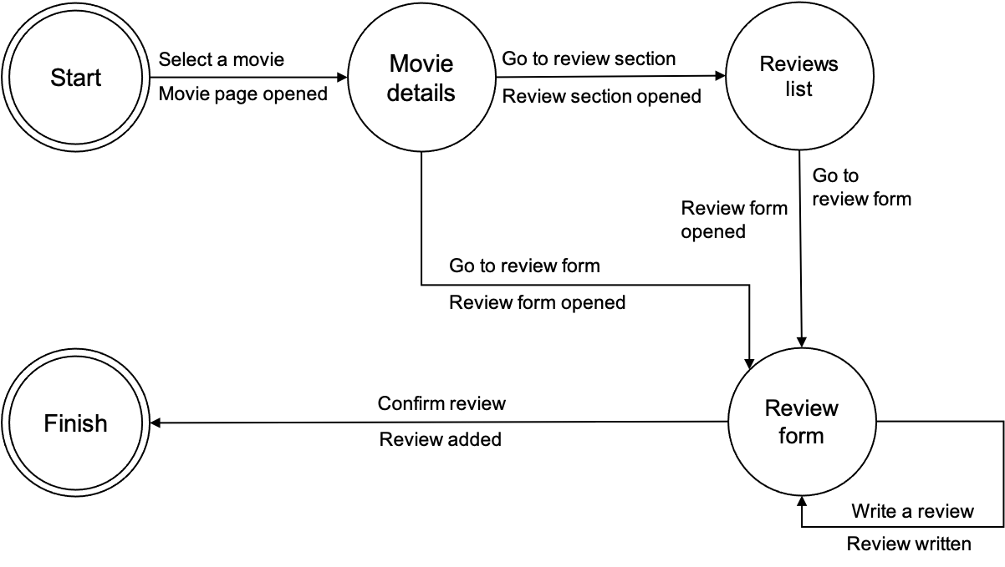
Make a review
The user can make a review regarding a movie. In particular, once he selected a movie, he can go to the review page either from the movie page or from the page containing all reviews.
HTA
STN

Slide 17
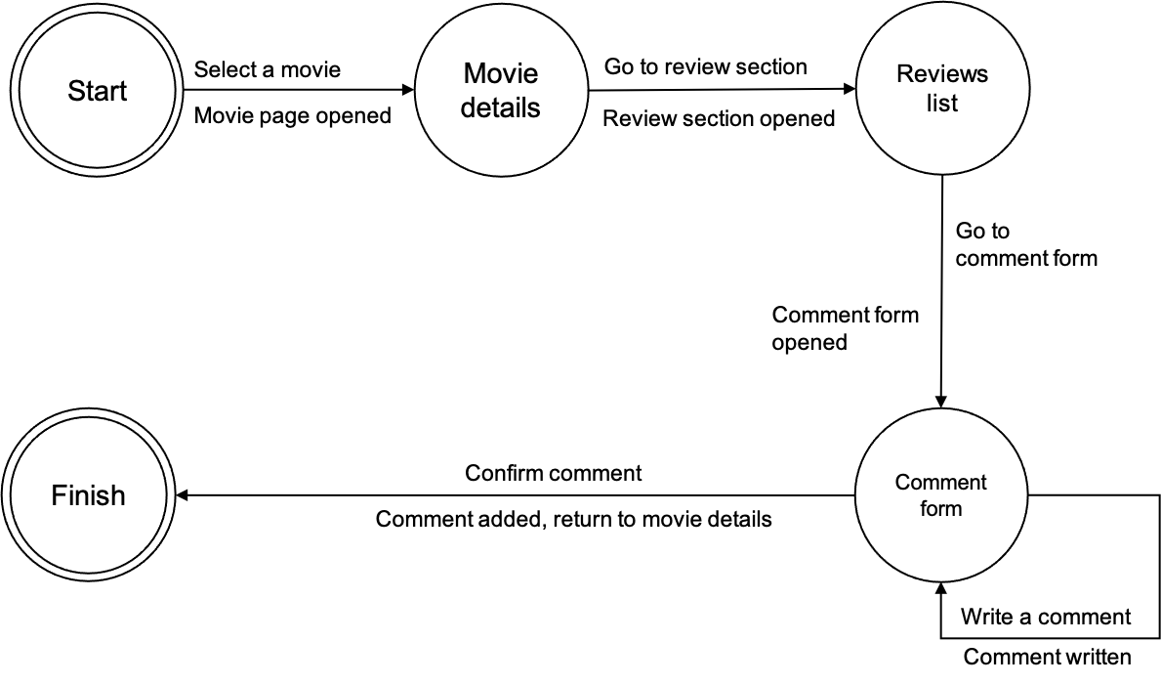
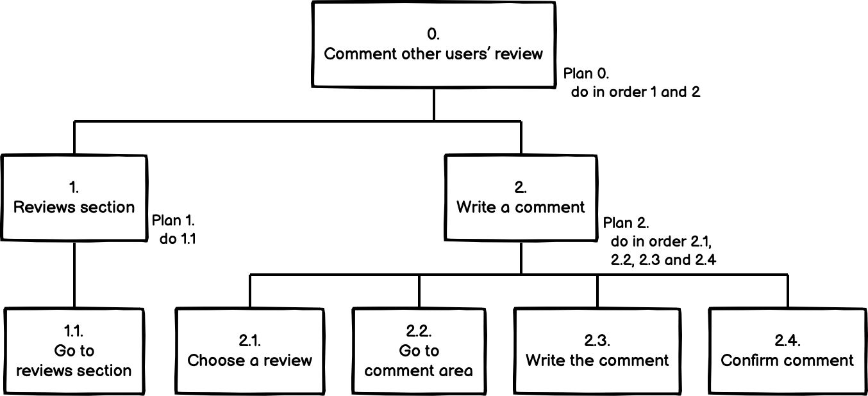
Comment other users’ reviews
The user can comment a review written by another user. In particular he can go to the page containing all the reviews, choose one of them and comment it.
HTA
STN

Slide 18
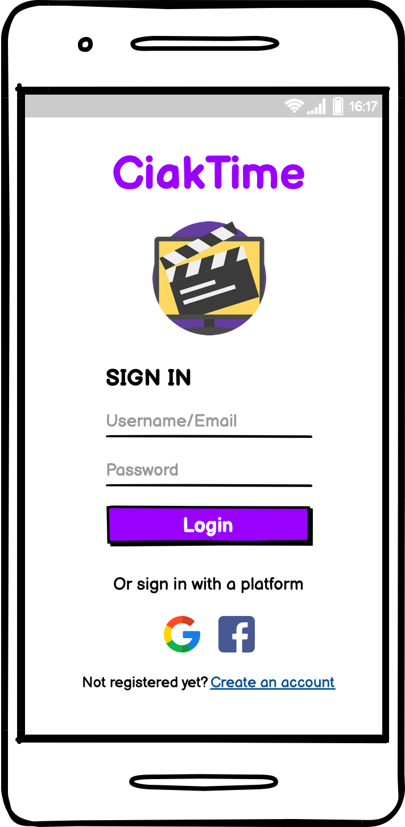
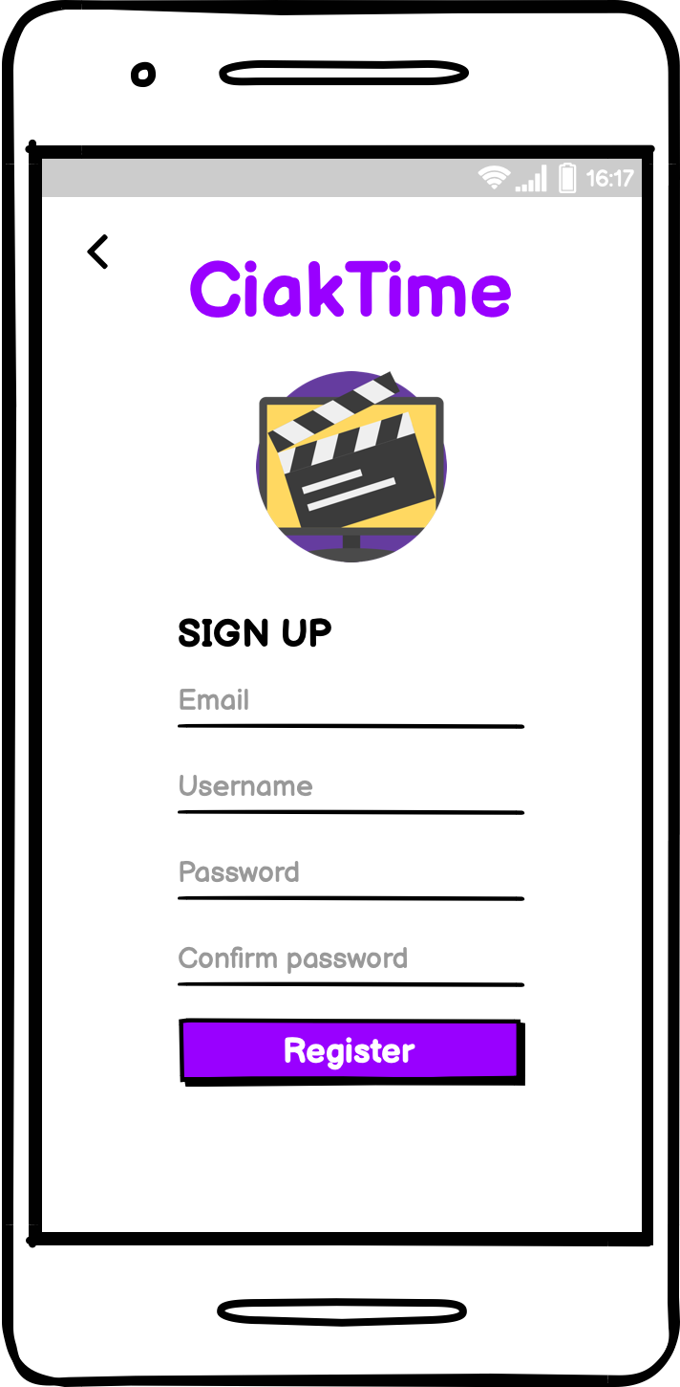
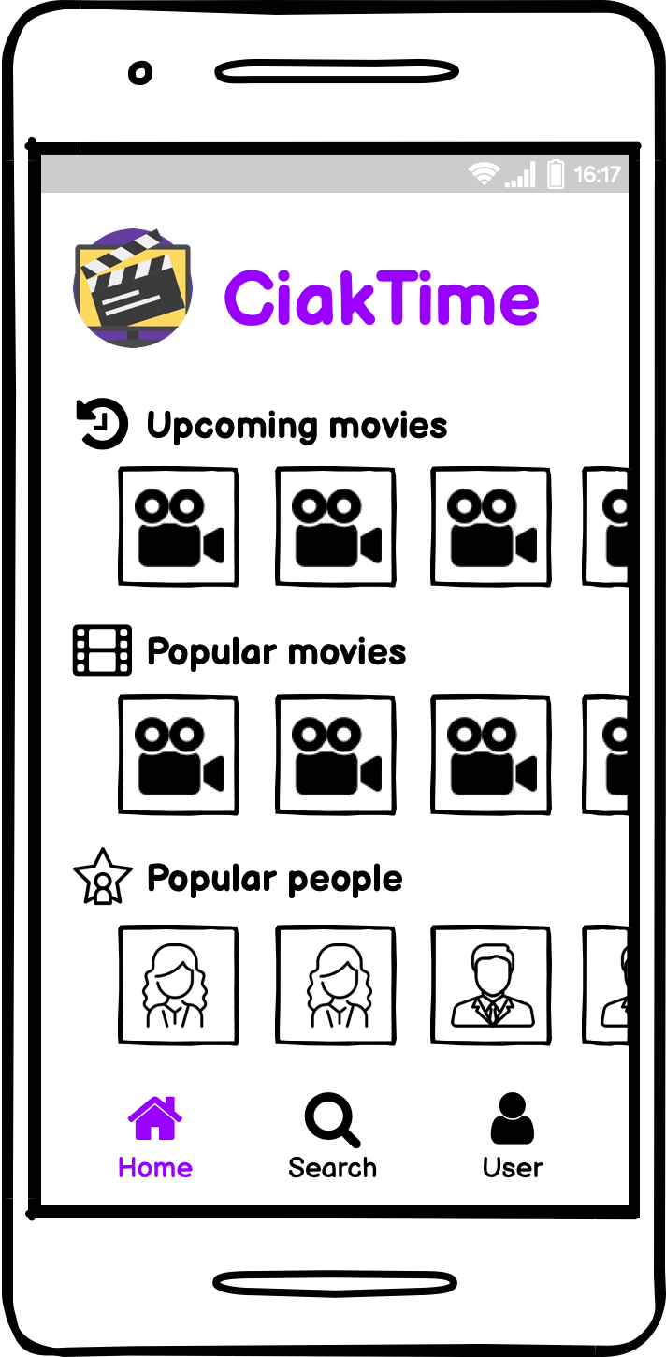
Prototype 0 - Mockups
We realized our first prototype realized through mockups in Balsamiq Wireframes.
The main interfaces of this prototype are:
Login and registration of a user.
Search for a movie or a person.
Add a movie to a list.
Review a movie.
Comment other reviews.
Login page
Registration page
Homepage

Slide 19
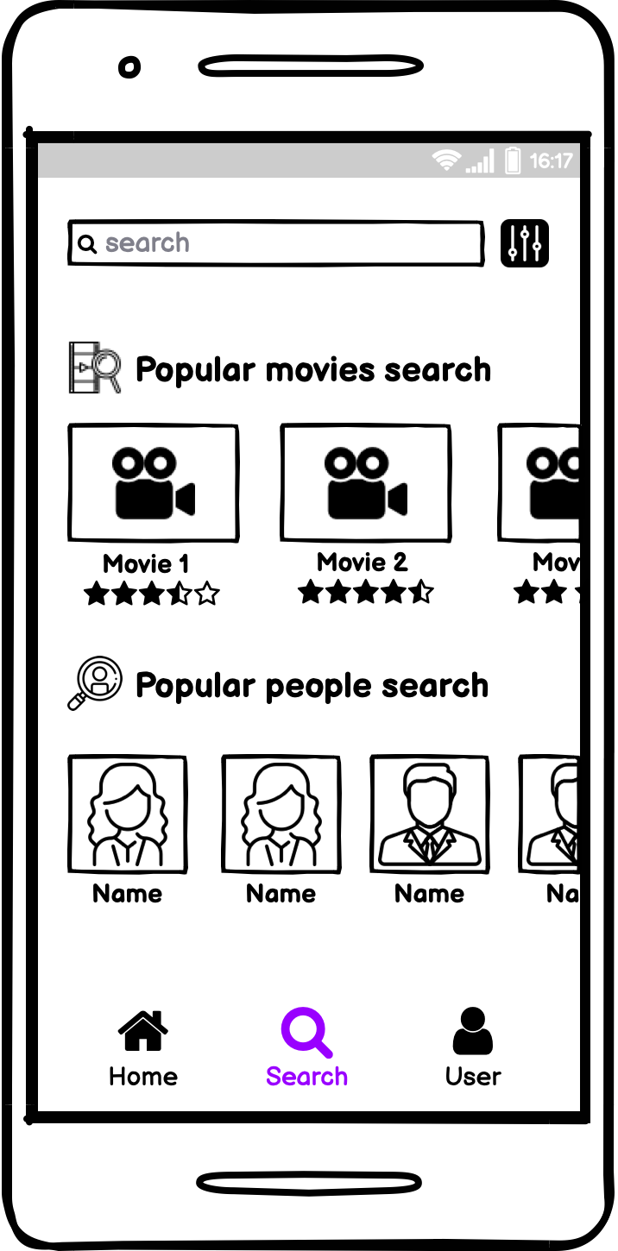
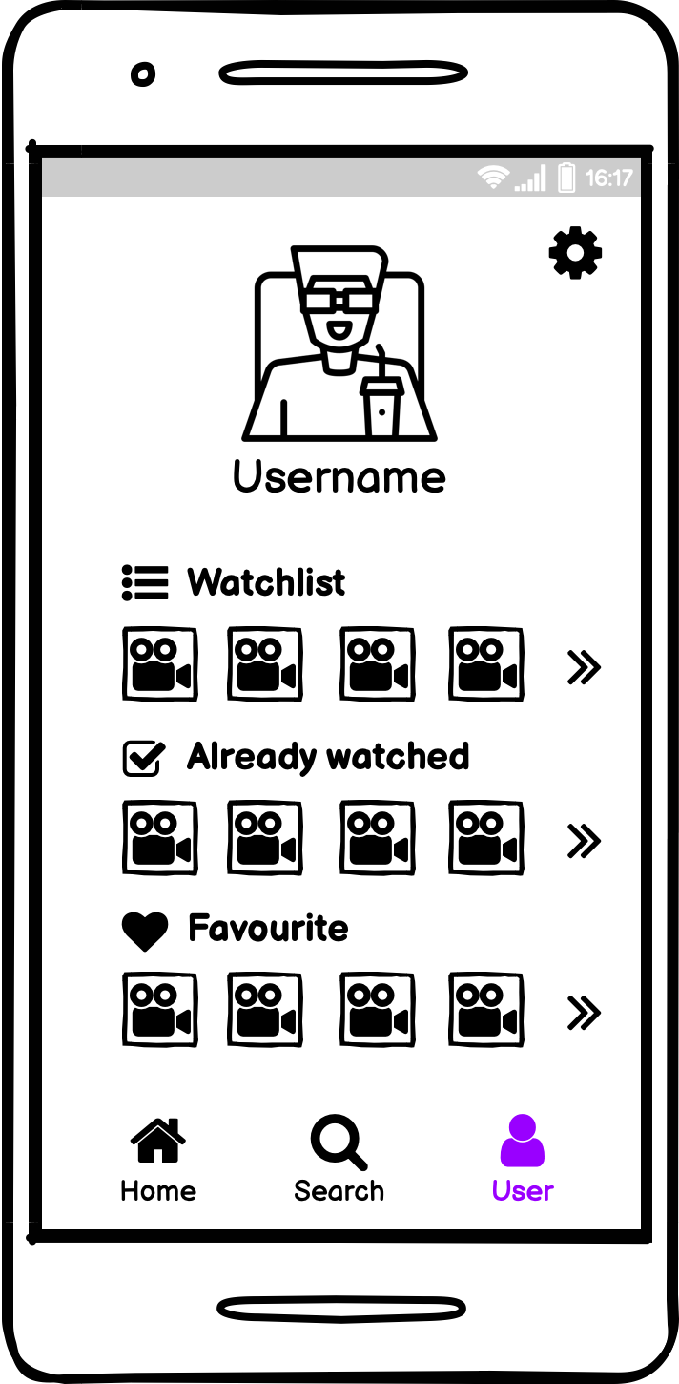
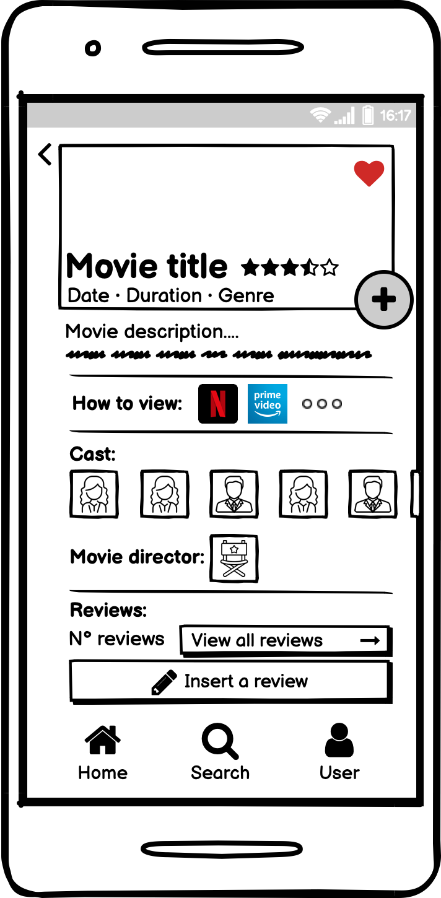
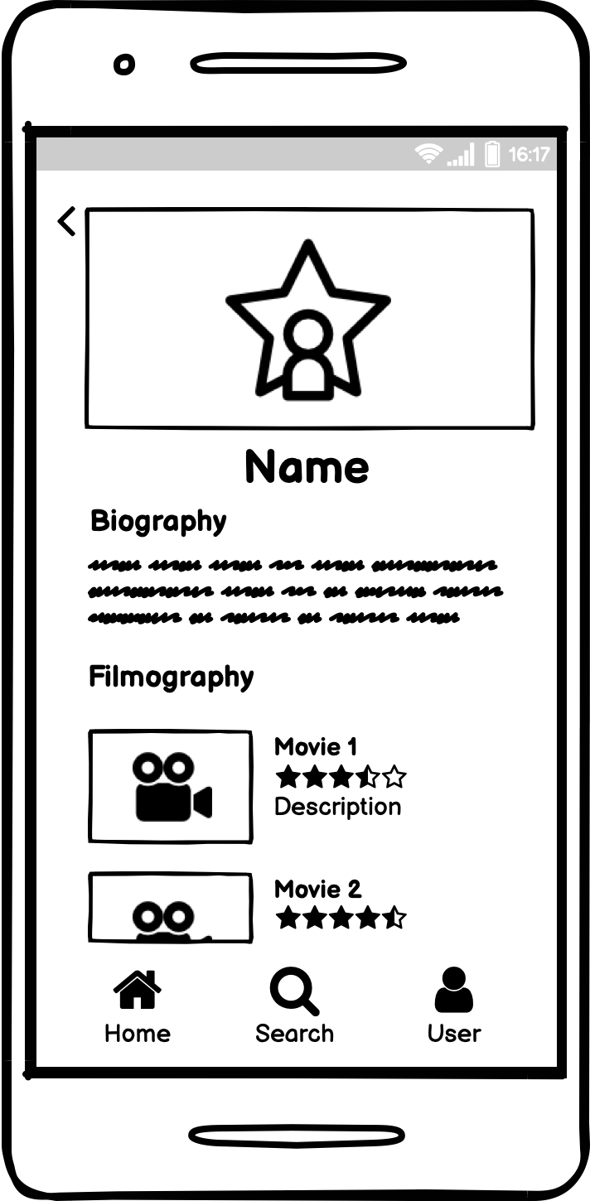
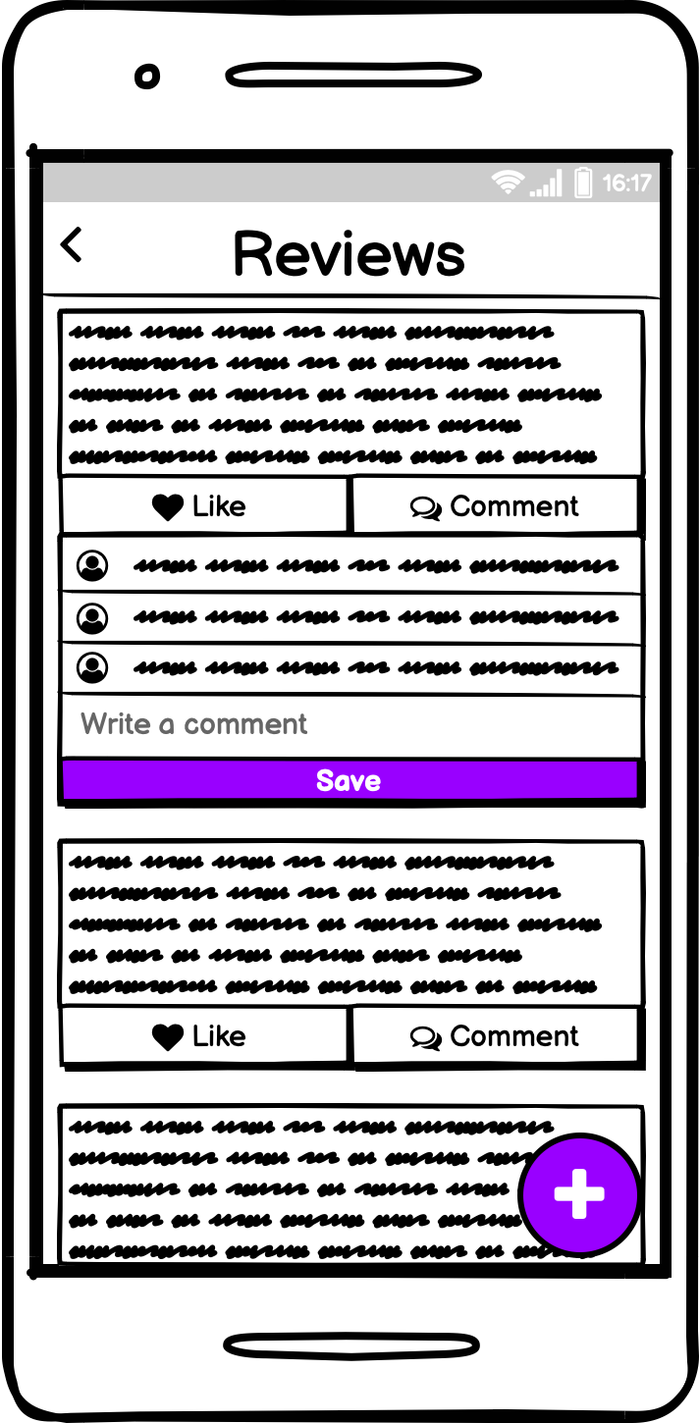
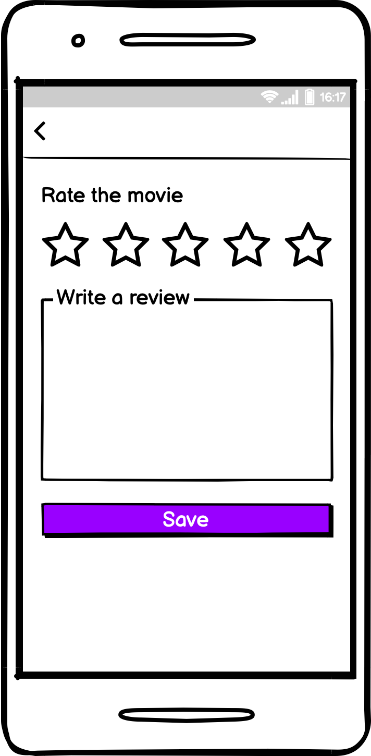
Prototype 0 - Mockups
Search page
User page
Movie page
Person page
Reviews page
Make a review page

Slide 20
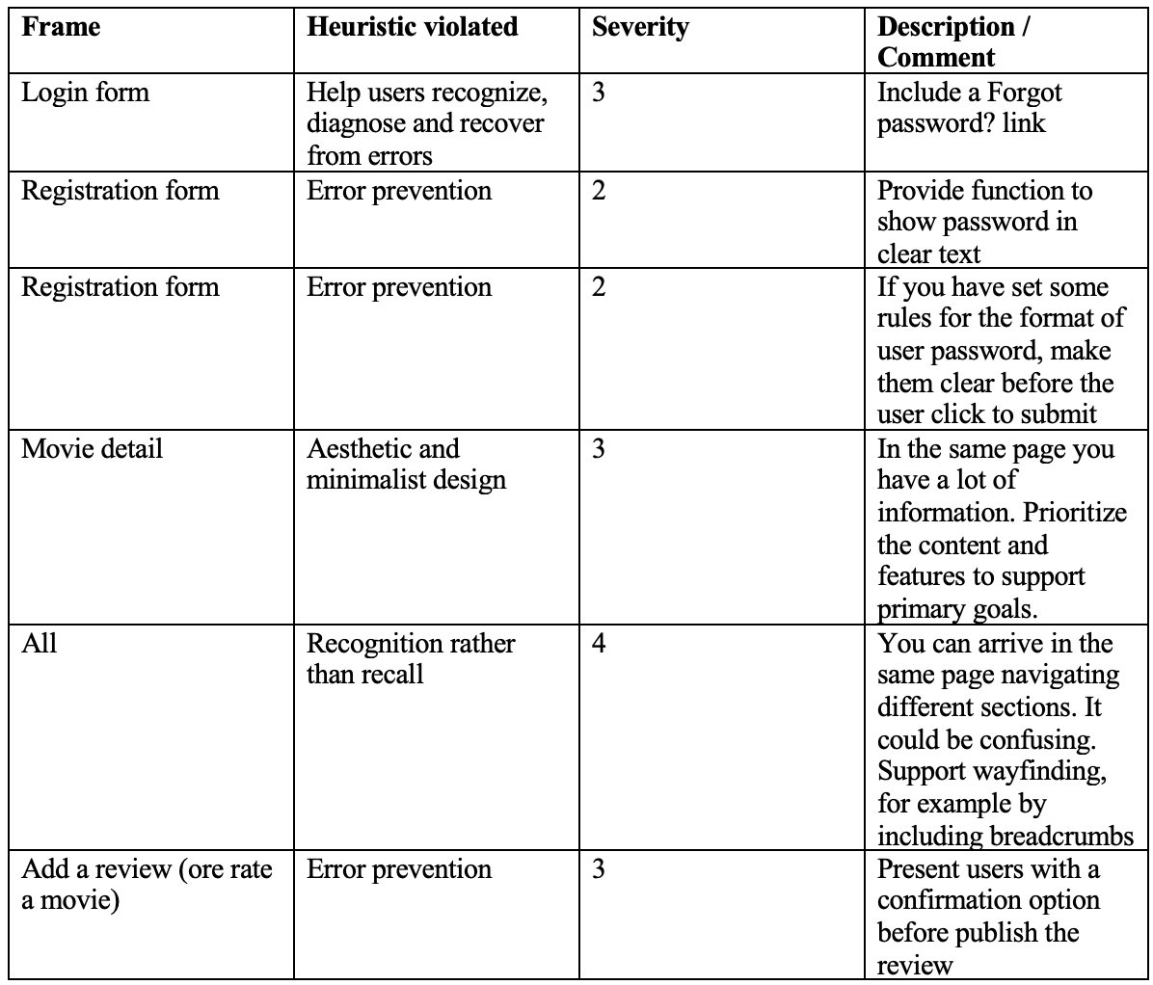
Heuristic evaluation

Slide 21
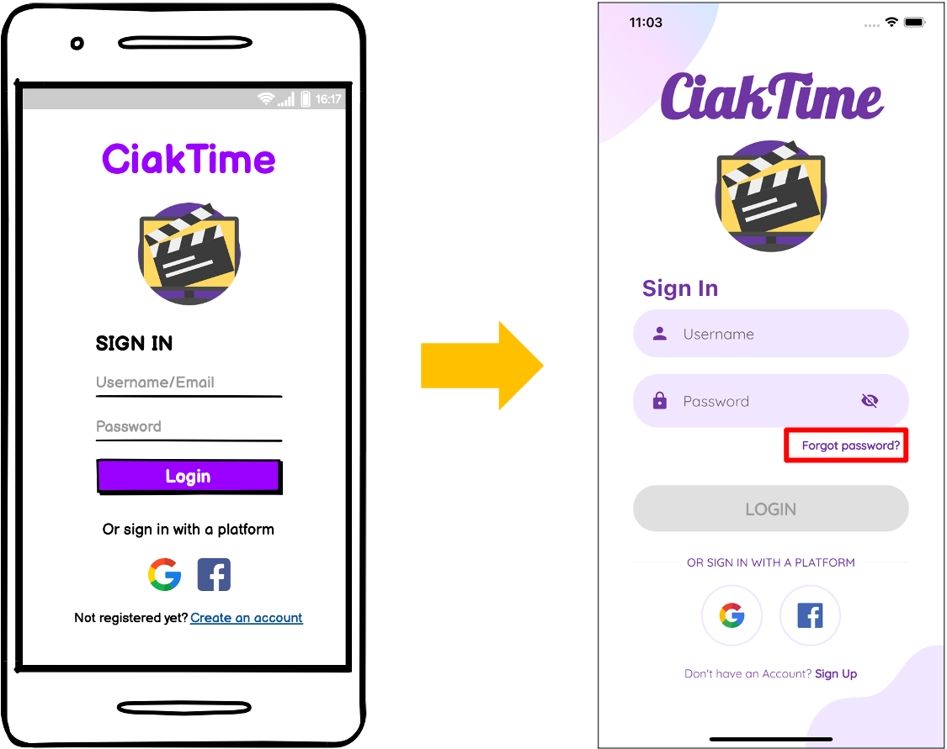
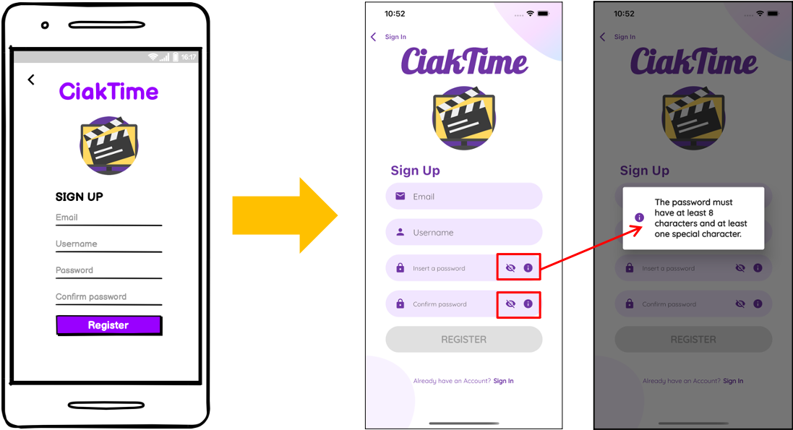
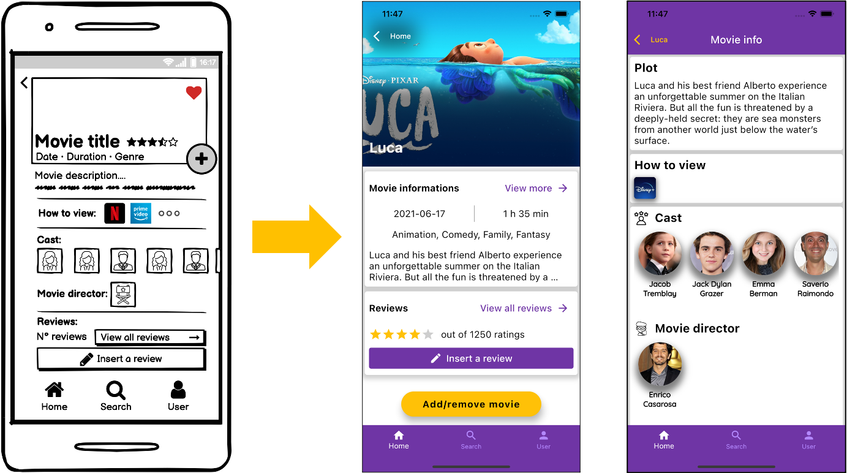
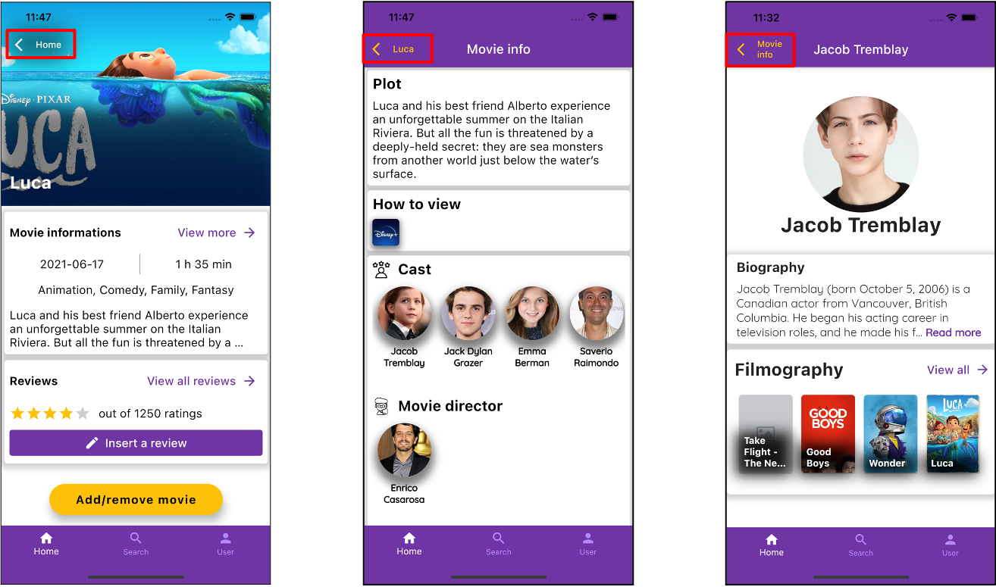
“Forgot password?” link added
“Show/hide password” button and information button added
”Movie” and “Movie info” pages
Wayfinding support added to all pages

Slide 22
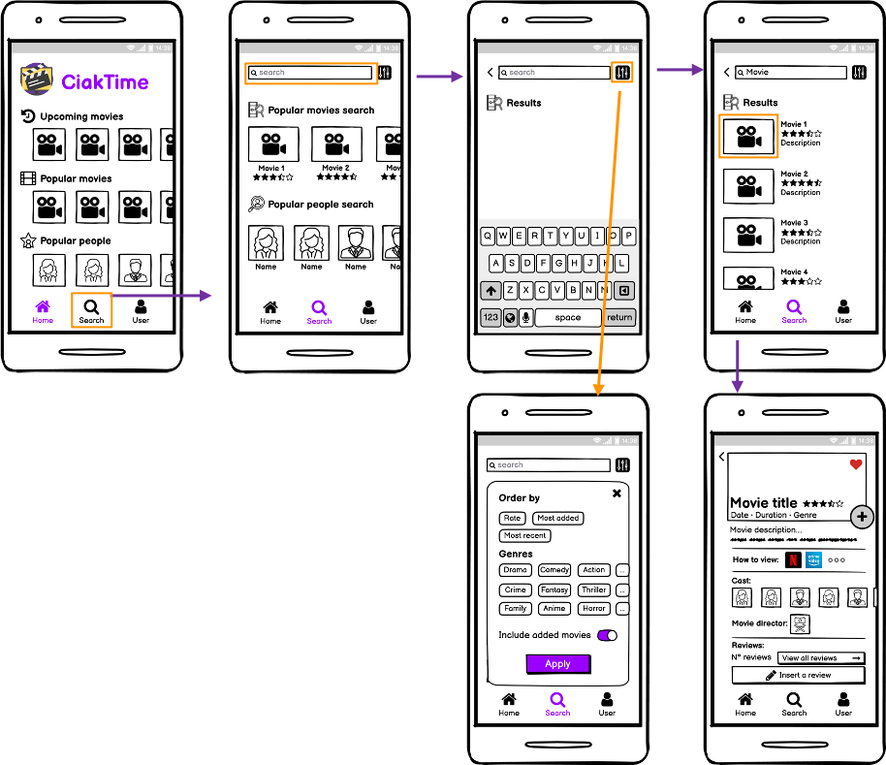
Cognitive Walkthrough
Task 1: Search the movie “Harry Potter and the Deathly Hallows - Part 2” to see the movie details.
Action 1: open the application (assuming that the user is already logged in) Response 1: homepage is opened
Action 2: tap on the search icon Response 2: the search page is displayed
Action 3: tap on the search bar Response 3: the keyboard shows up
Action 4: type “Harry Potter” Response 4: each digit is displayed as typed and the system shows the corresponding results
Action 5 – 6 – 7: [OPTIONAL] tap on filters’ icon, select “most recent” filter and tap on apply Response 7: the system shows the results according to the chosen filter
Action 8: select “Harry Potter and the Deathly Hallows - Part 2” from the list of the results Response 8: the systems shows the page of the selected movie containing all the related details

Slide 23
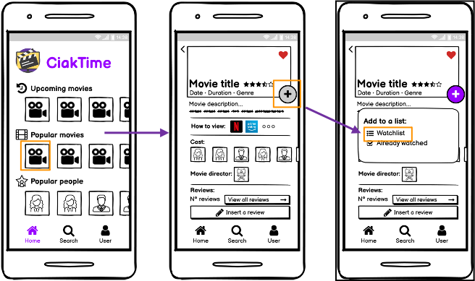
Cognitive Walkthrough
Task 2: Add a popular movie to the watchlist.
Action 1: open the application (assuming that the user is already logged in) Response 1: homepage is opened
Action 2: tap on a movie from “popular movies” section Response 2: the movies page is displayed
Action 3: tap on the “+” button Response 3: lists’ popup is displayed
Action 4: tap on watchlist Response 4: the movie is added to watchlist

Slide 24
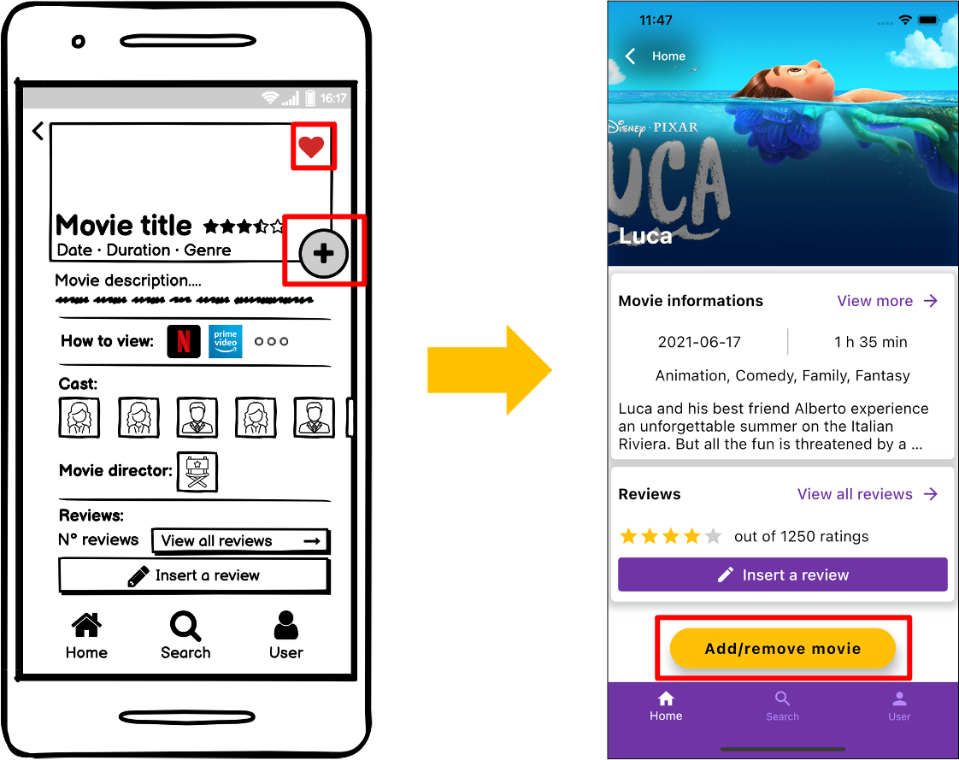
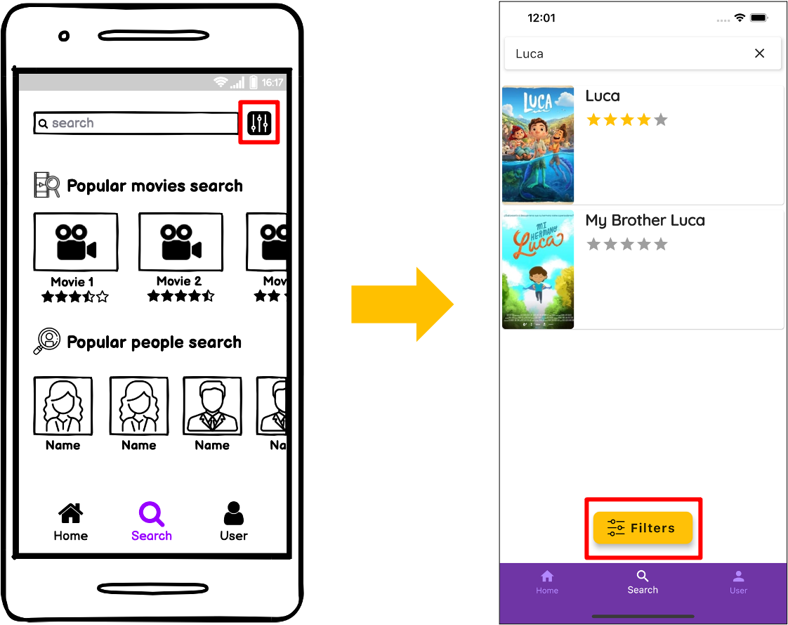
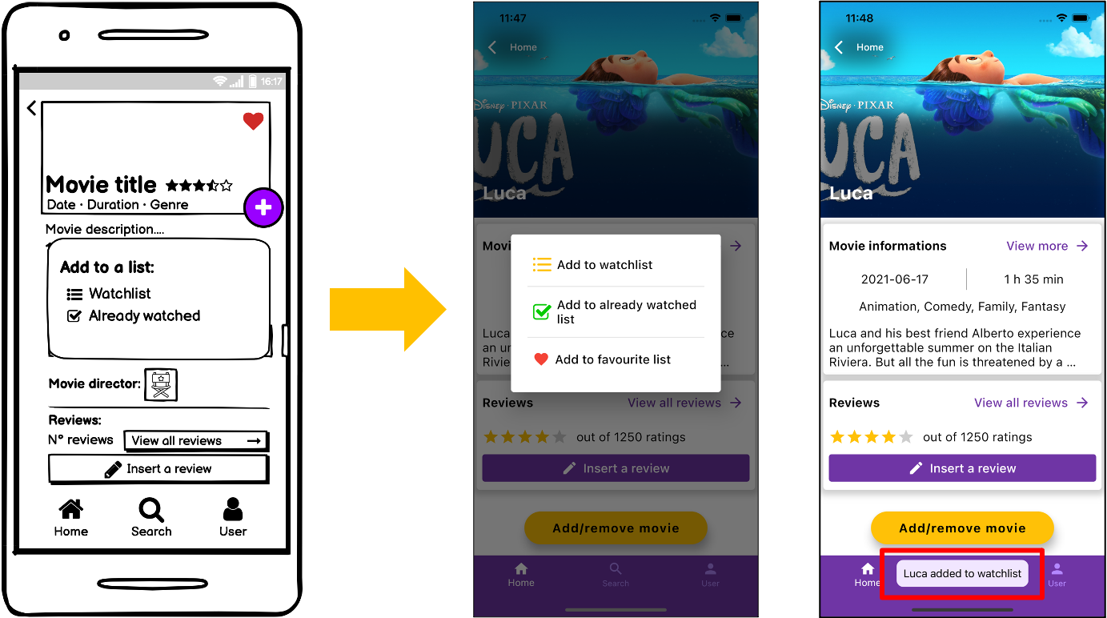
“+” and “heart icon” buttons modified
“Filters” button modified
Toast added

Slide 25
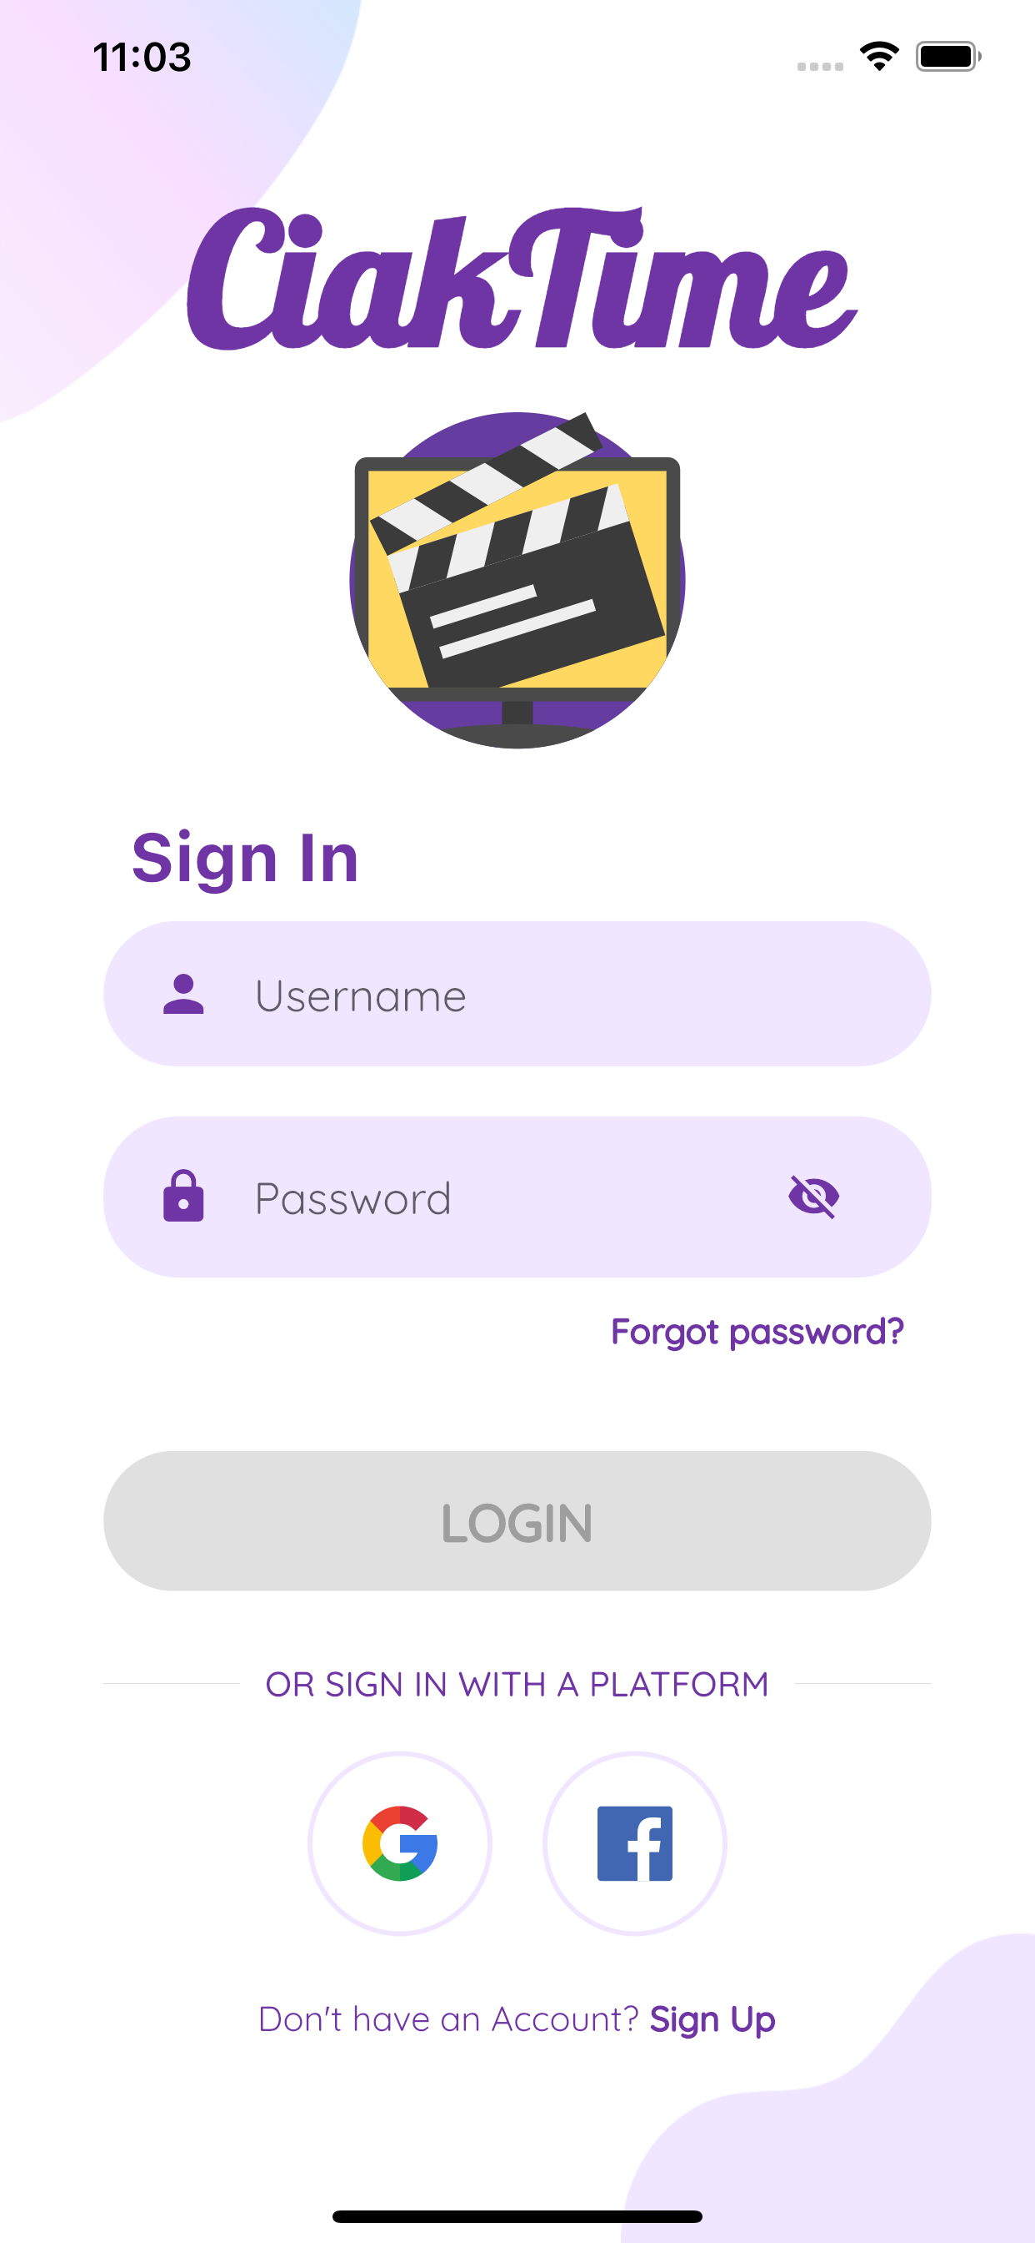
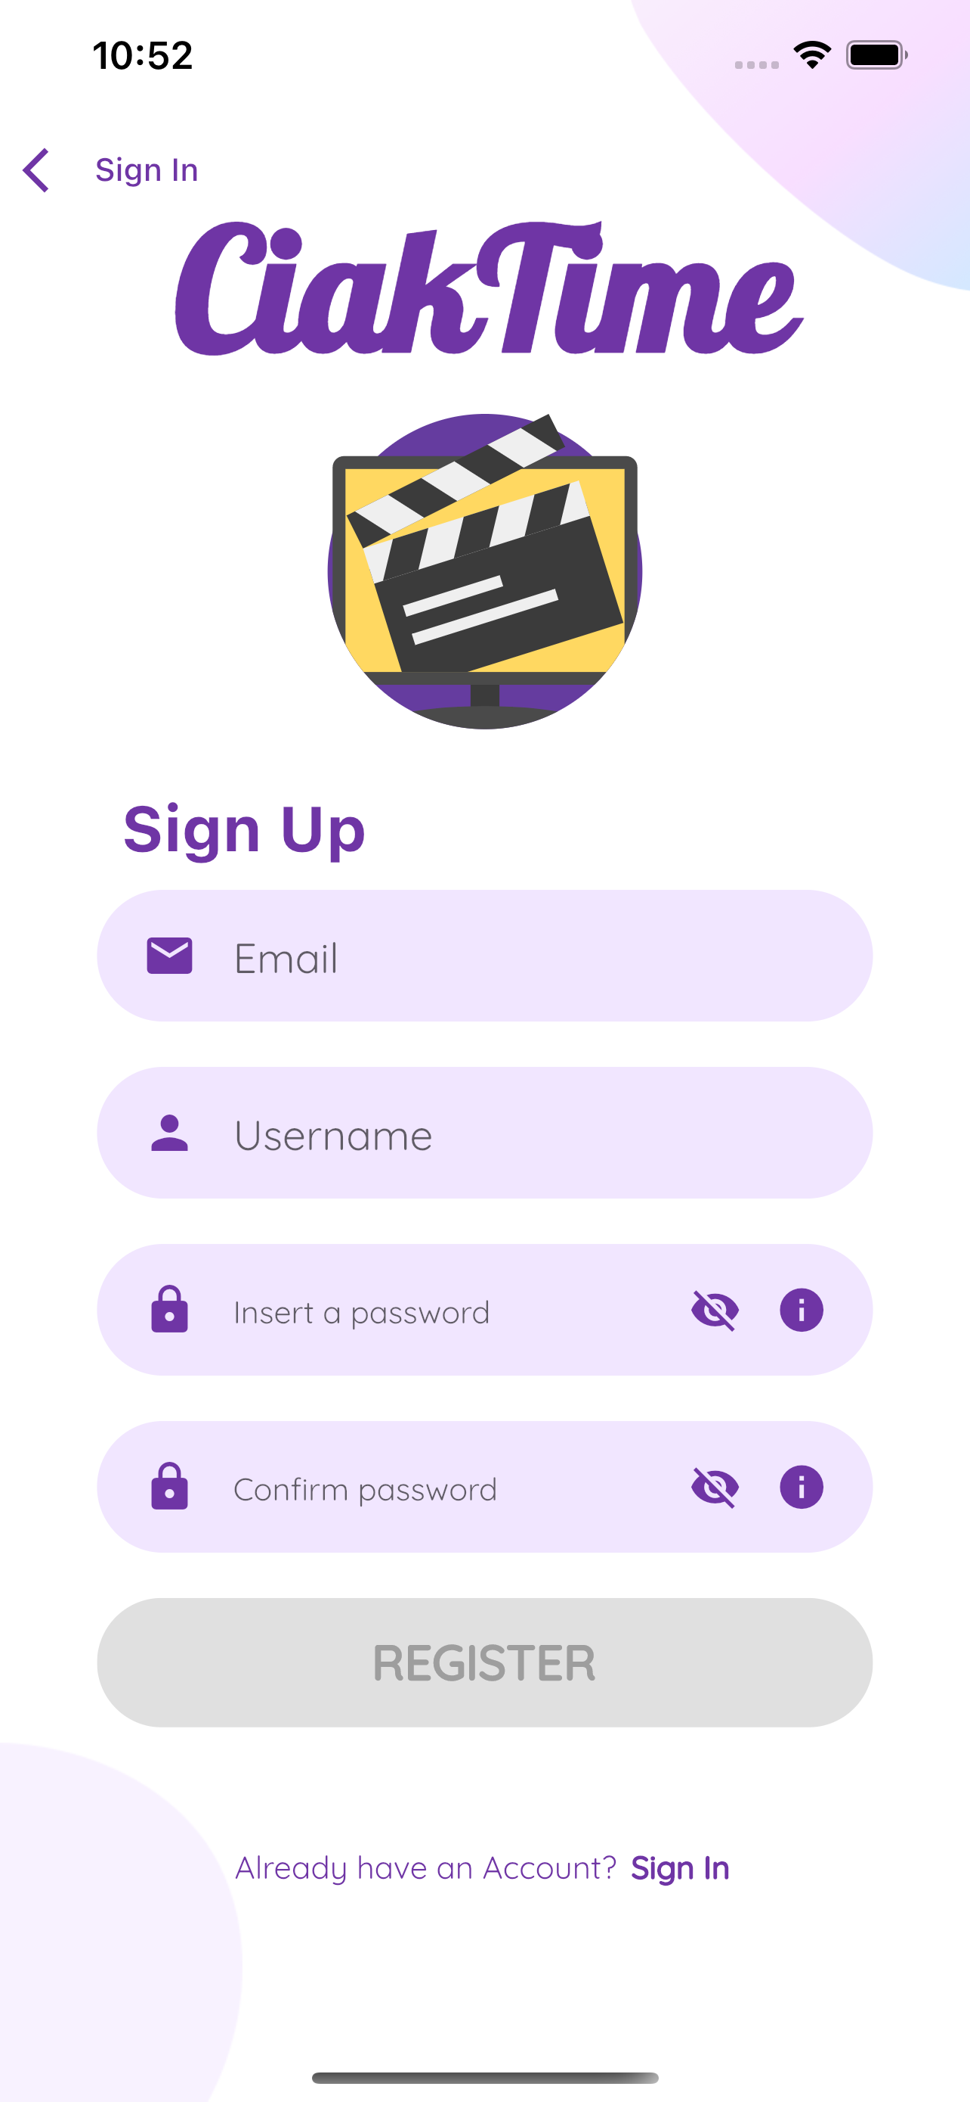
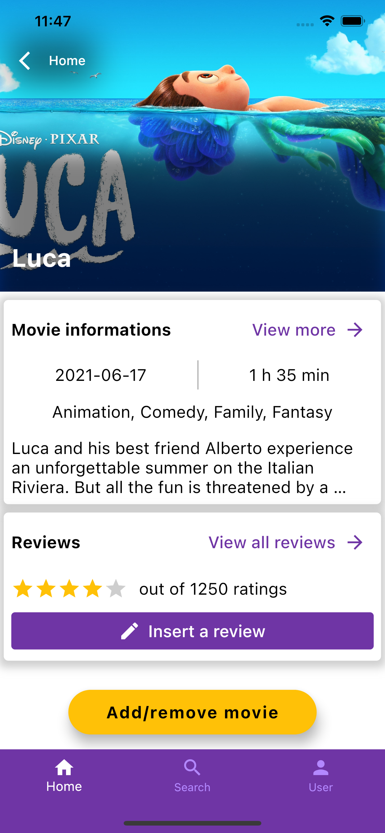
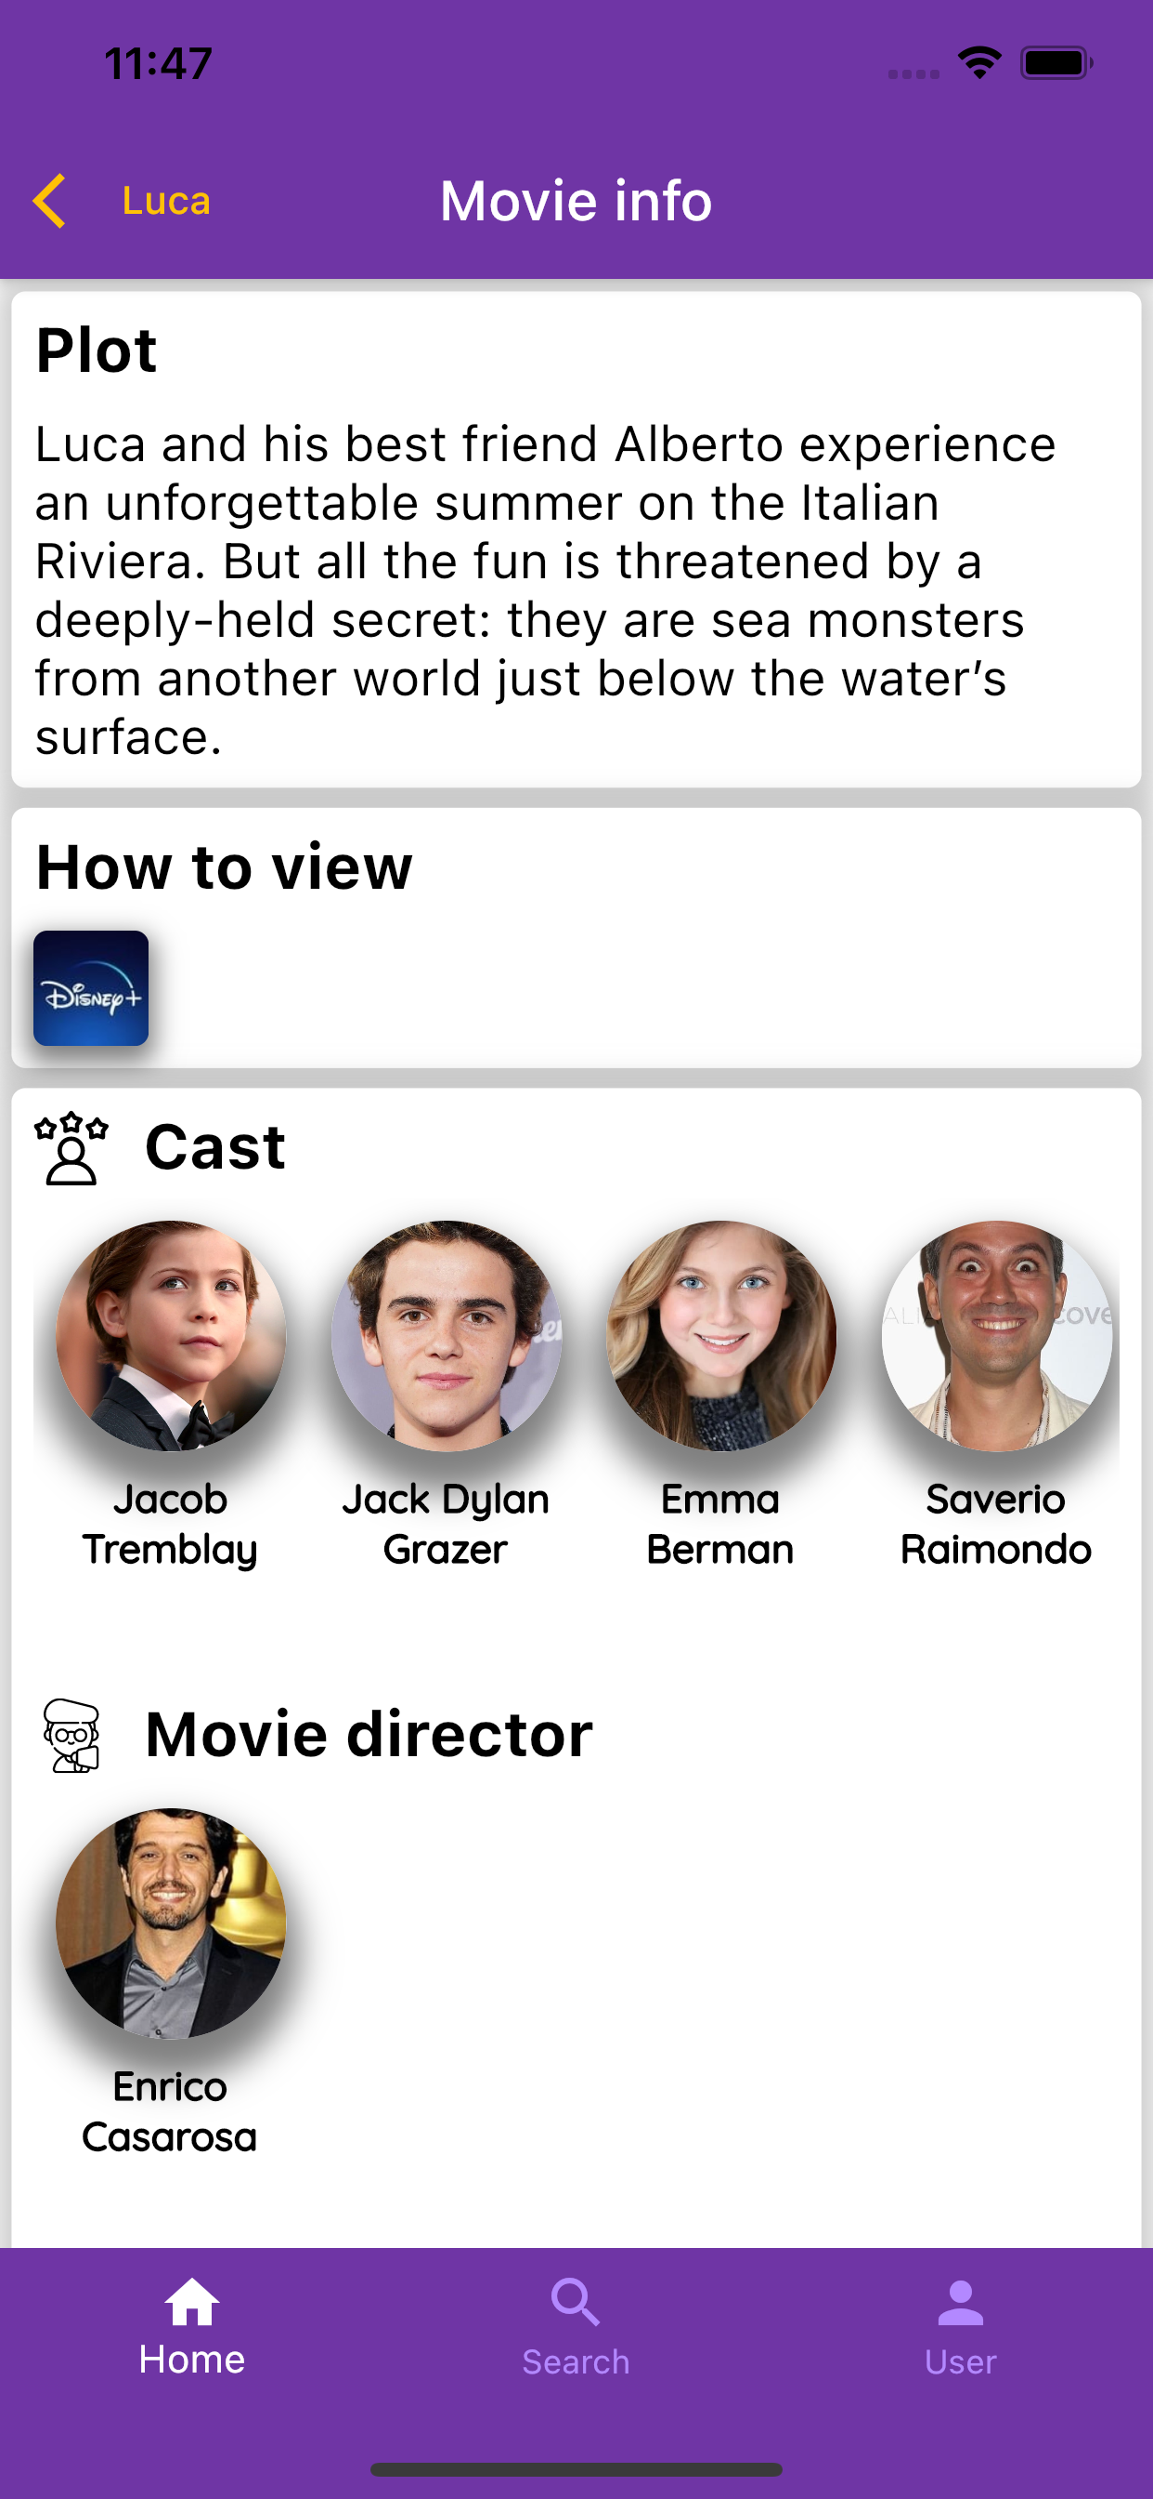
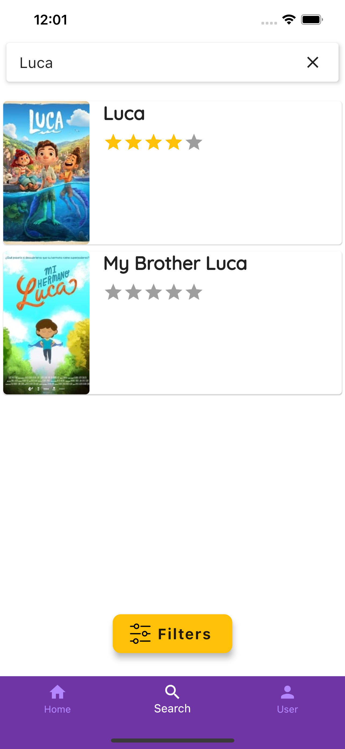
Prototype 1
After prototype 0, we have realized Prototype 1 as a real system through Flutter framework and Dart programming language, both on Android and iOS operating systems, by also making corrections based on expert evaluation.

Slide 26
Think Aloud
Task 1: Recently a lot of people are talking about the new Disney’s movie called ”Luca”. So, in order to understand the reason behind that, you would like to read its plot. After having noticed that the plot is interesting, you would like to add that movie into your ”Watchlist” in order to watch it in future.
Task 2: After having watched the movie ”Luca”, you would like to leave a review about this movie and add it to your ”Already Watched” list.
Task 3: You really liked the movie ”The lord of the rings: the fellowship of the ring” and you would know who is the movie director and which other movies he has directed. After having done this search, you would like to go back to the search page in order to do other searches.
Issue:
Some users tried to tap on the three dots at the end of the plot instead the “View more” button, in order to read the entire plot.
No issue
No issue

Slide 27
Interviews
On person search results they would prefer to have specified whether a person is an actor or a movie director.
On the “Movie info” page they would prefer to have specified who is the character that a certain actor plays in that movie.
Search between movies and persons should be separated.

Slide 28
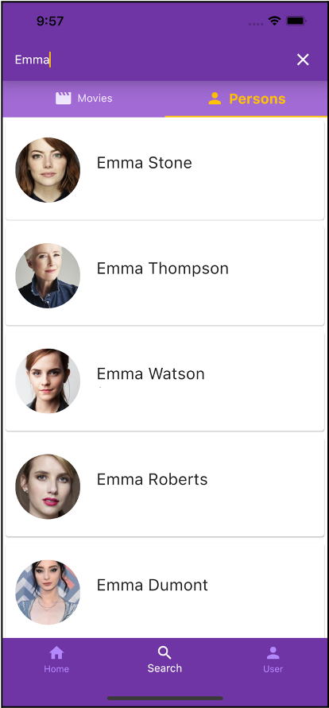
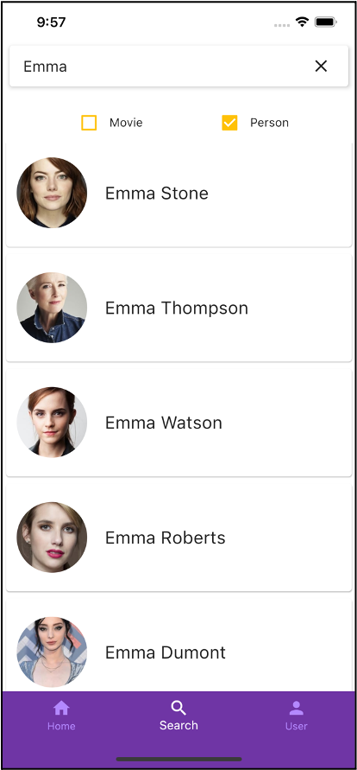
Controlled experiment
Task: You find the actress Emma Watson very good, so you would like get more information about her filmography.
Independent variables:
Dependent variable: time taken to complete the given task.
Hypothesis: Users will operate quicker with the Version 1 rather than the Version 2 of the interface.
Null hypothesis: There will be no speed difference between the two versions.
Participants: We involved a total of 10 different participants in a range between twenty - thirty years old, using the within-groups method.
Version 1 - Tab bar
Version 2 - Checkbox

Slide 29
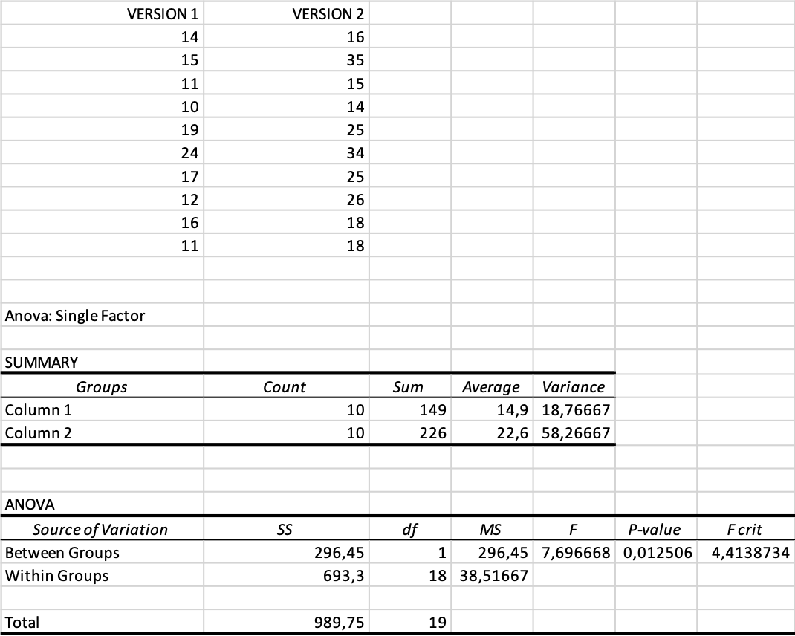
Controlled experiment - ANOVA

Slide 30
Thanks for your attention
Now we will show a demo of the real system

